Slide 1


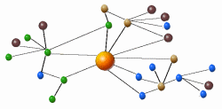


Diffusion of Information & Innovations in Online Social Networks
Krishna Gummadi
Networked Systems Research Group
Max Planck Institute for Software Systems
Notes:
Good afternoon. I am very excited to meet you all and talk about my work.
Today I’m going to talk about measurement and analysis issues in Internet systems.
[remember to show excitement!]
End a sentence in a low voice -- assertion
Don’t say “I’d like to say that…”
Mention collaborators. Then, it’s okay to say “we”

Slide 2
My goals and methodology
Goals: Understand & build complex systems
  example: online social networks
Methodology: Evolve the systems with feedback
  observe deployed systems
  extract insights
  test new designs and architectural principles
Notes:
Are not enough from first principles

Slide 3
My research:
Enabling the Social Web
Three fundamental trends & challenges in social Web
1. User-generated content sharing
  can we protect privacy of users sharing personal data?
2. Word-of-mouth based content exchange
  can we understand & leverage word-of-mouth better??
3. Crowd-sourcing content rating and ranking
  can we find trustworthy & relevant content sources?

Slide 4
Information discovery in Online Social Networks
Discovering information on the Web
  old method: Browsing from authoritative sources
  new method: Word-of-mouth from friends
Lots of theories & beliefs about viral propagation
  but few are empirically derived or validated at scale!
Large-scale empirical studies only possible recently
Notes:
Talk about some theories and beliefs here

Slide 5
Research problems
Understand dynamics of propagation
  Temporal and spatial patterns of propagation
  Role of social network, social systems, and user influence
For different types of information and innovations
  News, web URLs, conventions, and technology services
With the ultimate goal of enabling better viral campaigns
  Consumers: Help them get content they would not otherwise receive
  Publishers: Help them spread their content more effectively
Notes:
Data is available, so we are able to work on them.
Helping advertisers is very important. Every industry needs advertisement.
Tremor: 200,000 influential teens

Slide 6

Why ?
One of the most popular social media
Social links are the primary way how information flows
  Users can follow any public messages, called tweets, they like
Traditional media sources and word-of-mouth coexist
  Mainstream media sources (BBC, CNN, DowningSteet)
  Celebrities (Oprah Winfrey), politicians (Barack Obama)
  Ordinary users (like you and me!)
Notes:
Twitter has media sources, local opinion leaders, all the way down to ordinary users

Slide 7
Dataset
Crawled near-complete data from Twitter till August 2009
  asked Twitter to white-list 58 machines
  crawled information about user profiles and all tweets ever posted
  starting from user ID of 0 to 80 million
Gathered 54M users, 2B follow links, and 1.7B tweets
  user profile includes join date, name, location, time zone
  exact time stamp of tweets available
Notes:
Not needed to say 0 to 80 million users.
This is by far the largest dataset about tweets.
-- other people have… first studies to have crawled the tweets exhaustively.
Only mention relevant thing if it
Mention other groups
also have it, but ours
is complete in tweets

Slide 8
Studies of information diffusion
How web URLs are discovered in Twitter [IMC ‘11]
How news spreads in Twitter [ICWSM ‘11]
The role of offline geography in Twitter [ICWSM 2012]
How social conventions emerge in Twitter [ICWSM 2012]
  social norms are fundamental to social psychology and social life
  social conventions are like social norms, before they become tied to group identity and before deviant behavior is sanctioned

Slide 9
Macroscopic analysis:
Who passes information to whom
With Fabrício Benevenuto (UFOP) Hamed Haddadi (QMUL)
Meeyoung Cha (KAIST)

Slide 10
High-level network characteristics
95% of users belong to the largest connected component (LCC)
  5% were singletons and 0.2% formed 32K smaller components
Low reciprocity (10%)
Power-law node degree distribution with extremely large hubs
  Grassroots users, on average, have 37 followers (98% had <200 followers)
  0.01% users had >100,000 followers
Notes:
Trends in LCC: 37 links/node, 33.6 tweets/user
We do not see high degree nodes

Slide 11
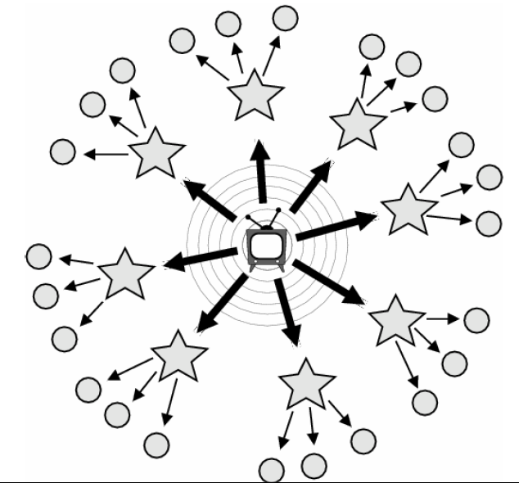
Theory of information flow
Two-step flow of influence by Katz and Lazarsfeld (1940s)
  Not all people are equally influential
  A minority of opinion leaders influence everyone else
  Mass media influence the opinion leaders, hence the two-step flow
Notes:
Briefly give you an Idea of historical work and terminology
Traditional model: categories of people.
Diffusion of Innovations Rogers 1962 , Weimann
Ideas spread well beyond academia (Gladwell 2000)
One in ten Americans tells the other nine how to vote, where to eat, and what to buy.” (Keller and Berry, 2003)
Elihu katz

Slide 12
Interesting questions
Can we identify the different groups in Twitter?
What fraction of audience can each group reach?

Slide 13
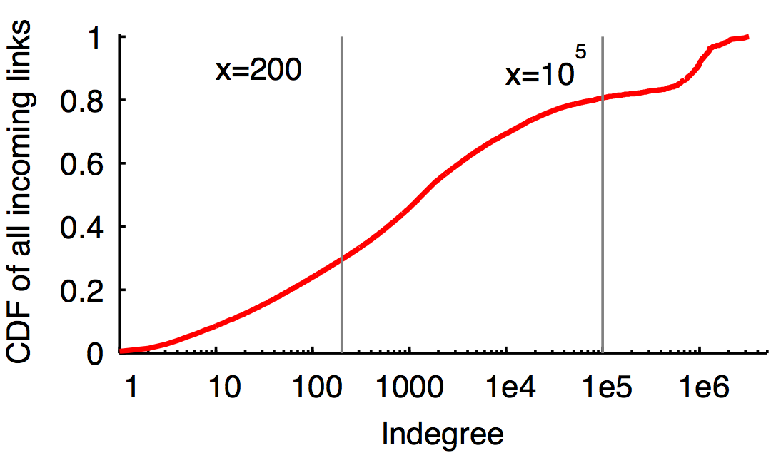
How do we identify different groups?
Grassroots
Evangelists
Mass media
51M (98.6%)
700,000 (1.4%)
8,000 (<0.01%)

Slide 14
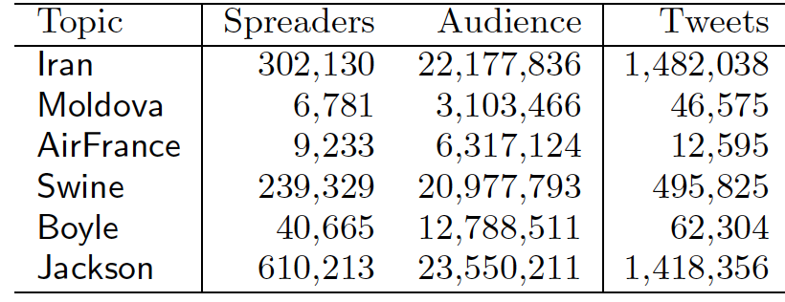
Major news events studied
Picked six major news topics in 2009
  Used keywords to identify relevant tweets
  Limited study to a 2 month period
50-80% grassroots
18-48% evangelists
<0.1% mass media
All events reached
millions of audience
Notes:
The major similarities between these events are the ratio between grassroots, evangelists, and mass media
Dissimilarity is the difference in orders of magnitude of spreaders disappear in audience.
RT and URL rates are more than 100 times higher than for an average tweet.
URL is especially interesting. This is because of brevity of messages on Twitter.
Tweets related to news events often contain links to external websites where more detailed content can be found.
We later use URL to track down information.

Slide 15
Audience reach: Sufficiency
  Sufficiency—Audience that can be reached by the top K spreaders
rank 2
rank 1
rank 3
Spreader
Audience

Slide 16
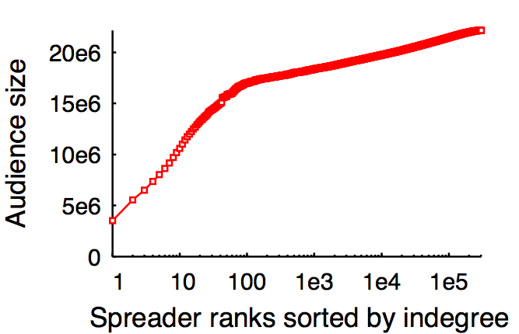
Sufficiency test in Iran election
Mass media
Evangelists
Grassroots
Notes:
Spreader -> tweeter
== Spend more time in explaining X and Y-axis, don’t loose people ===

Slide 17
Audience reach: Necessity
  Necessary—Audience that are still reachable after removing the top K spreaders, i.e., audience would otherwise not be reachable
rank 2
rank 1
rank 3
Spreader
Audience
Notes:
== Spend more time in the concept, why is this important? ===
It is important to know how many users are needed to reach a given audience size. But it’s also important to know if those users must exist to reach such audience, or other users could have reached the same audience. Therefore we need to check necessity condition.

Slide 18
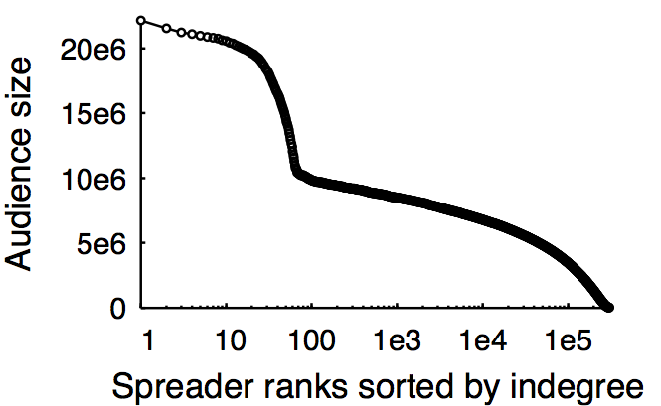
Necessity test in Iran election
Mass media
Evangelists
Grassroots

Slide 19
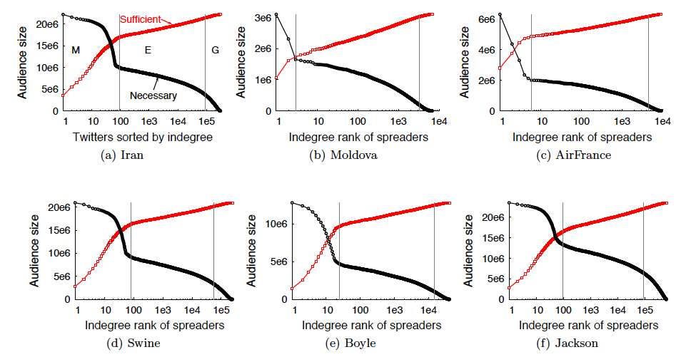
Audience reach of popular topics
Mass media alone
reach the majority
of all audience
Evangelists
increase the reach
considerably
Grassroots play
marginal role
Notes:
== Spend more time in explaining the differences between graphs, make sure everyone understand the graph ===
Strikingly similar trends.
So it seems that the hype about word-of-mouth is mostly about evangelists, but not on grassroots.
In case of Jackson and Swine, more people were reached by grassroots. Patterns do vary depending on the nature of the event.

Slide 20
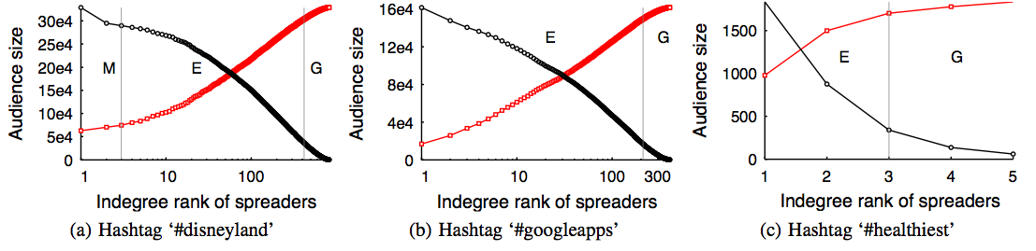
Audience reach of non-popular topics
Mass media may
not be present
Evangelists group
consistently reach
large audience
Grassroots play
marginal role
Evangelists group need more attention in viral marketing
Existing influence measures fail to appreciate their role
Notes:
Mass media may not be present (often plays no role)
Evangelists play a dominant role
Grassroots still play a relatively marginal role.
Strikingly similar trends.
So it seems that the hype about word-of-mouth is mostly about evangelists, but not on grassroots.
In case of Jackson and Swine, more people were reached by grassroots. Patterns do vary depending on the nature of the event.

Slide 21
Summary of macroscopic analysis
Teased out the roles of mass media, evangelist, and grassroots users in the spread of major and minor events
  Mass media are important for spreading popular topics
  Evangelists play a crucial role for both popular and non-popular topics
  Grassroots play a marginal role in all cases
Studied information spreading patterns across groups
  Information flows in all directions unlike in the two-step flow theory
Notes:
Mass media are important role for popular topics
Evangelists play non-insignificant role for popular topic but significant role for non-popular topic

Slide 22
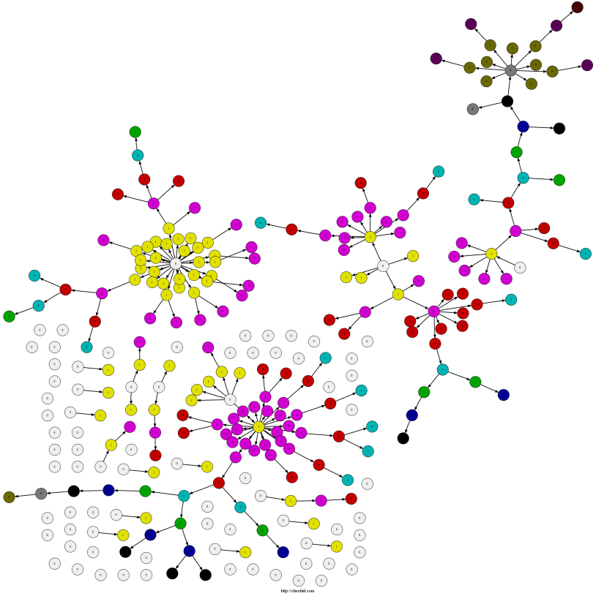
A more closer look:
Patterns of URL propagation
With Tiago Rodrigues (UFMG)
Fabrício Benevenuto (UFOP)
Meeyoung Cha (KAIST)

Slide 23
Interesting questions
What types of content are discovered by Word-of-Mouth?
What are the structures of Word-of-Mouth propagation trees?
How geographically distributed are the propagation trees?
Notes:
Due to the importance of understanding how people discover information in online social media, in this paper we provide a large scale analysis of Word-of-Mouth web based content discovery on Twitter, a popular microblogging service.
We answered several interesting research questions in this some. Some of the questions are: read the questions

Slide 24

Why URLs on Twitter?
Ideal for studying Word-of-Mouth
  Centered around the idea of spreading information
  Easy to trace their propagation
208M URLs shared on Twitter from 2006 -- 2009
Notes:
First, why did we decide to study URLs propagation on Twitter?
For those who don’t know, Twitter is an online social network and microblogging service where users can share messages of 140 characters, called tweets. Users follow each other and receive all tweets from whom they follow. Twitter presents several characteristics that made it an ideal medium to study WoM. It is centered around the idea of spreading information, as users follow whom they want to receive information from. Some additional mechanisms like retweets are provided to quickly share an information. The retweet is act of forwarding other people’s tweet. As Twitter limits a tweet to only 140 characters, several URL shortening services emerged recently. These services embed a long url into a shorter one. When the shorter URL is requested, the service redirects to the original one.
We decided to study URLs for two main reasons. First, because URLs are popular on Twitter. For example, in our datasets we observed about 208 million URLs shared in a period of 3 years on Twitter. The second reason it is because URLs are simple to track. Tracking a topic, like Steve Jobs death, for example, is much harder than a single URL.

Slide 25
Modeling Information Cascades
Hierarchical tree model
A
T | User | Tweet content
B
C
D
Notes:
We modeled the propagation cascades using a Hierarchical tree model. Consider an example of a social network on Twitter with 4 users: A, B, C and D. In this network, user B follows and receive all tweets posted by user A. Users C and D follow user B.

Slide 26
Modeling Information Cascades
Hierarchical tree model
Initiator
A
T | User | Tweet content
1 | A | Check this: http://www.example.com/
B
Receiver
C
D
Notes:
At time 1, user A tweeted a URL. In this case, as user A did not receive the URL before from any followee, he is considered the initiator of the cascade tree. User B, who follows user A, received the URL and is considered a receiver.

Slide 27
Modeling Information Cascades
Hierarchical tree model
Initiator
A
T | User | Tweet content
1 | A | Check this: http://www.example.com/
2 | B | http://www.example.com/ is interesting
B
Spreader
C
D
Receiver
Receiver
Notes:
At time 2, user B retweeted user A. Then, is created an explicit link from A to B, in the direction where the information flowed. In this case, user B is now considered a spreader of the URL. Users C and D, who follow B, received the URL and are considered receivers.

Slide 28
Modeling Information Cascades
Hierarchical tree model
Initiator
A
T | User | Tweet content
1 | A | Check this: http://www.example.com/
2 | B | http://www.example.com/ is interesting
3 | C | Interesting link: http://www.example.com/
B
Spreader
C
D
Spreader
Receiver
Notes:
At time 3, user C tweeted the URL. As user C did not cite the source of the information, we infer and add an implicit link from user B to C. Now, user C is a spreader of the information.

Slide 29
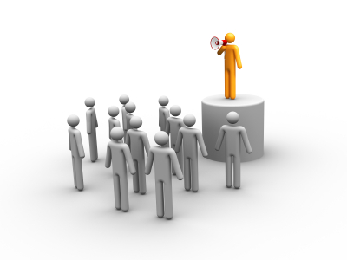
Modeling Information Cascades
Hierarchical tree model
Initiator
A
B
Spreader
Audience
C
D
Spreader
Receiver
Notes:
All users who received the information are considered as the audience. In our example, A, B, C and D are the audience for the URL shared. We used the audience size as a metric of popularity in some of our analysis.

Slide 30
Modeling Information Cascades
Hierarchical tree model
  URL propagation pattern is a forest
Initiator
A
Initiator
Initiator
G
E
B
Spreader
H
I
F
Spreader
Receiver
Receiver
C
D
Spreader
Receiver
Notes:
Note that in our hierarquical tree model, a single URL might have several cascade trees, like a forest. All users who first tweet a URL before receiving it from another user are considered initiators of a new cascade tree. In our example, if user G found the URL by searching and tweeted it independently, G is a initiator of a new cascade tree for that URL.
We chose this hierarchical tree model based on the patterns observed for the retweets, where users explicitly say from whom they got the information. Most part of the users who received the same information from many sources retweeted only the most recent source. So, in our model, the in-degree of any user except the initiator is 1. For the implicit links, when the user received the information from many sources, we considered the owner of most recent tweet as the source.

Slide 31
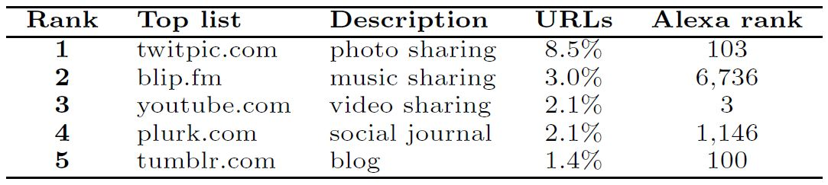
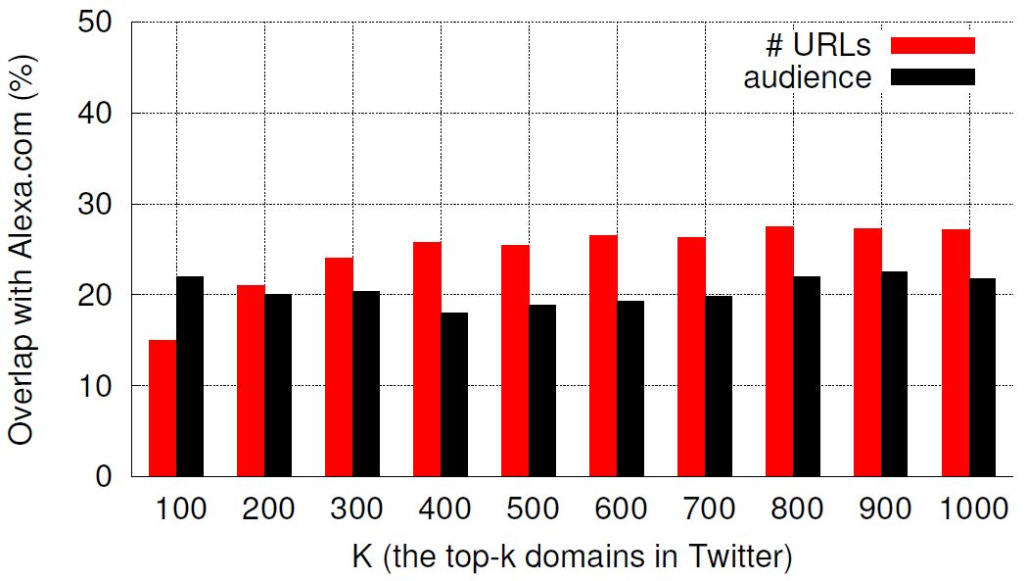
What URLs are popularly shared on Twitter? Do they come from the popular domains in the Web?
Word-of-mouth can help popularize niche content
Notes:
In order to answer the first question, we analyzed the popularity of the domains of the URLs shared on Twitter based on two popularity metrics: the number of URLs under the domain and the total audience of all URLs under the domain. The table shows the top 5 domains shared in our dataset, based on the number of URLs. Interestingly, all URLs are from social media services. The most popular is twitpic.com, a service to share photos on Twitter.
We also analyzed if the domain is popular outside Twitter based on alexa.com ranking Alexa.com is a web service that measures the traffic of the domains in the web. Interestingly, we observe that only youtube.com is among the top 5 most popular domains in the alexa.com ranking.
So, in the top 5 domains showed in the table, the overlap between alexa and Twitter rankings is 20%. In the figure we show the overlap until the top 1000 domains. About 25% of overlap is observed for the top 1000 URLs, for both popularity metrics used on Twitter, which means that WoM can help to popularize niche content.

Slide 32
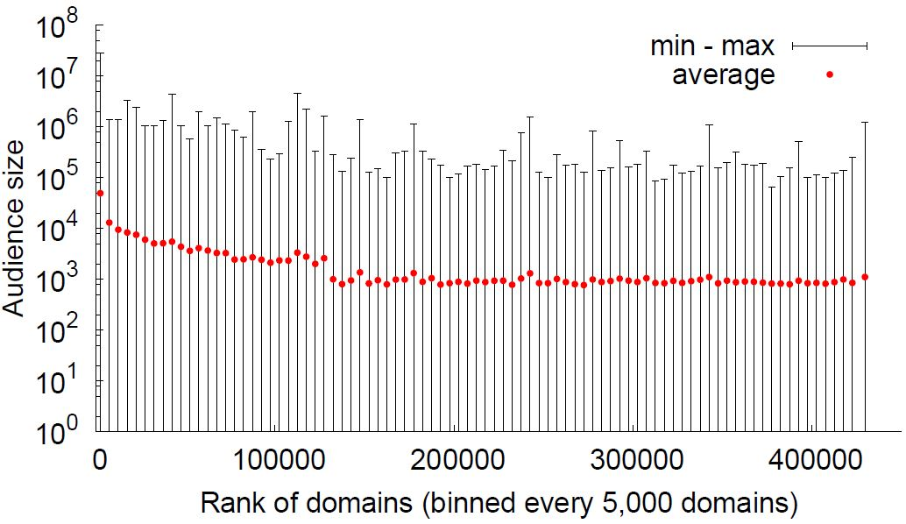
Does all content, including those published by unpopular domains, benefit from Word-of-Mouth?
Word-of-mouth gives all URLs and content (both popular and non-popular) a chance to become popular
Notes:
- We then wondered if all URLs, even those from unpopular domains, have a chance to became popular through WoM on Twitter. The figure shows the domains ranked by the number of URLs on the x-axis and the audience size reached by its most popular URL of the domain on the y-axis. To better visualization, we binned every 5,000 domains. We observe that, although on average URLs from most popular domains are more popular, some URLs from unpopular domains achieve an audience size considerable, some even higher than from URLs of popular domains. So, we can conclude that WoM gives … (read sentence)

Slide 33
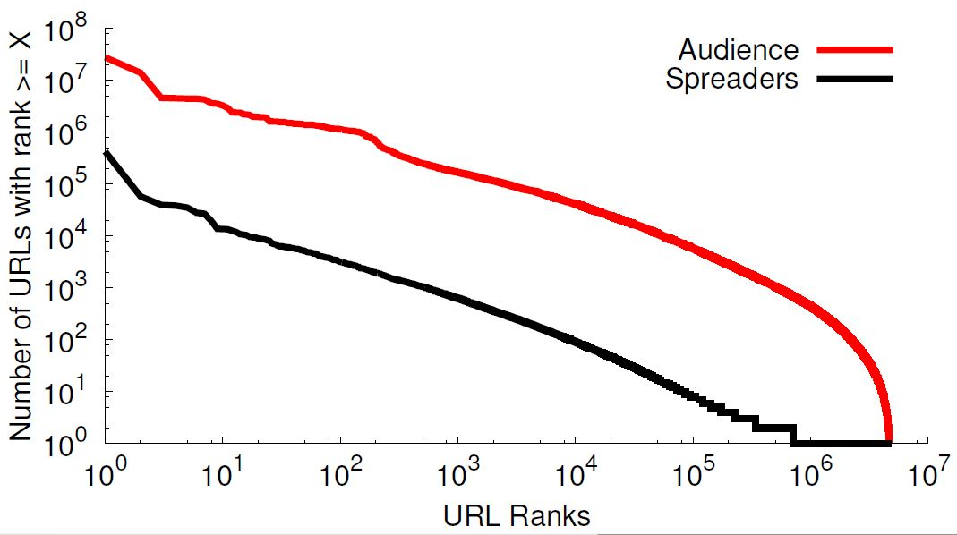
How large is the largest Word-of-Mouth?
URL popularity
  Most popular: 426,820 spreaders and audience of 28M users
  Average: 3 spreaders and audience of 843 users
Word-of-mouth can incur extremely large cascades
Notes:
We start by checking the popularity of the URLs on Twitter. The most popular URL was spreaded by more than 400,000 users and reached an audience of 28 million users, half of Twitter total size at that time. On average, the URLs have 3 spreaders and reached an audience of 843 users.
The figure shows the complimentary cumulative distribution function for the URLs popularity based on two metrics: audience size and number of spreaders. Both follow a Power-Law, which means that a few URLs are extremely popular, which most part is unpopular. In conclusion, popular cascades are rare on Twitter, but they are extremely large when they occur.

Slide 34
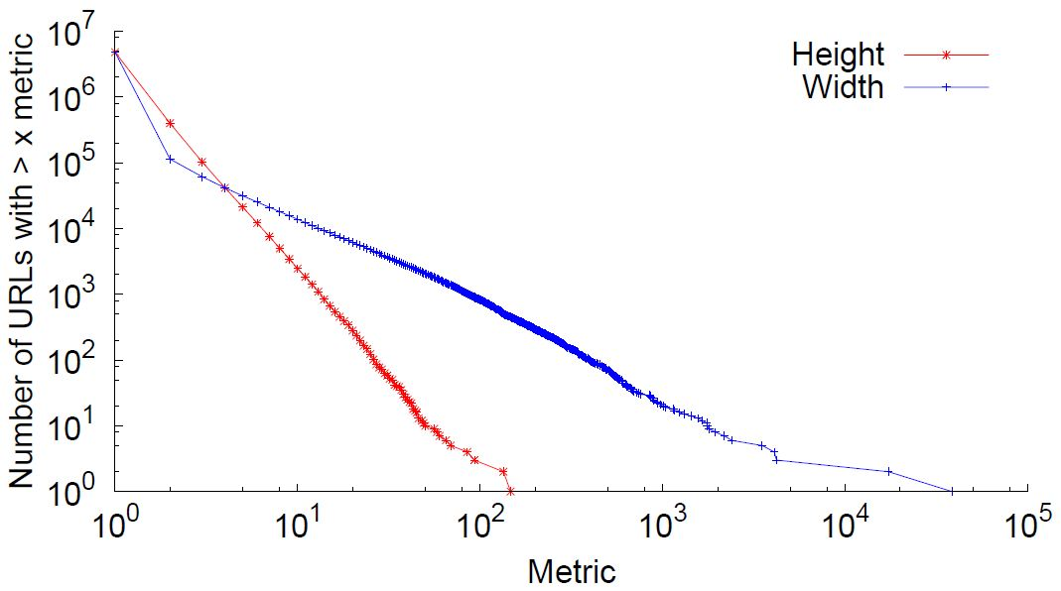
What are the typical structures of propagation trees?
Cascade trees are much wider than they are deep
  0.1% of the trees have width > 20
  0.005% of the trees have height > 20
A
147
38,418
3
B
C
D
2
Notes:
An aspect of the shape of the cascade trees is the height and width. The height is given by the largest path from the initiator to any spreader. On the example, the height is 3. The width is given by the maximum number of users at the same height. On the example, the width is 2.
The figure shows the CCDF distribution for the height and width of the largest cascade tree of each URL in our dataset. We observe that cascades on Twitter are much wider than they are deep. The maximum width observed was almost 40000 users, with the height was only 147.

Slide 35
What are the typical structures of propagation trees?
Notes:
An aspect of the shape of the cascade trees is the height and width. The height is given by the largest path from the initiator to any spreader. On the example, the height is 3. The width is given by the maximum number of users at the same height. On the example, the width is 2.
The figure shows the CCDF distribution for the height and width of the largest cascade tree of each URL in our dataset. We observe that cascades on Twitter are much wider than they are deep. The maximum width observed was almost 40000 users, with the height was only 147.

Slide 36
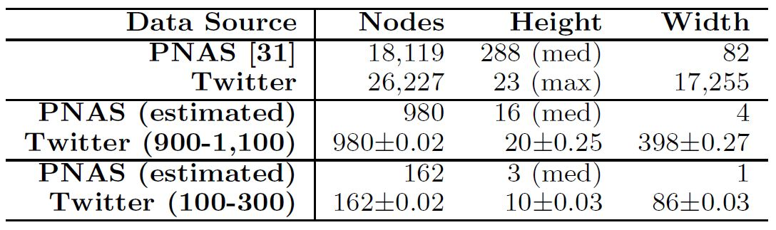
Twitter Cascades vs. E-mail Cascades
D. Liben-Nowell and J. Kleinberg
  Tracing Information Flow on a Global Scale using Internet Chain-Letter Data, PNAS, 2008
Twitter
e-mail
Notes:
These wide and shalow cascades are typical from Twitter. Liben-Nowell and Kleinberg analyzed the circulation of a petition on the US-Iraq war through e-mail messages, and the cascade analyzed is the opposite of the most common on Twitter. In the e-mail cascade, they reach more than 18 thousand users, and the medium height is 288 while the maximum width is 82. We have a Twitter cascade with about 26 thousand users, the maximum height is only 23 while the width in more than 17 thousand users.
We believe that characteristics of the environment might explain the differences. On Twitter, if I have 1M followers and tweet a URL, all of these 1M users will receive it instantaneouly. In e-mail I need to manually add 1M users if I want to send messages to them.

Slide 37

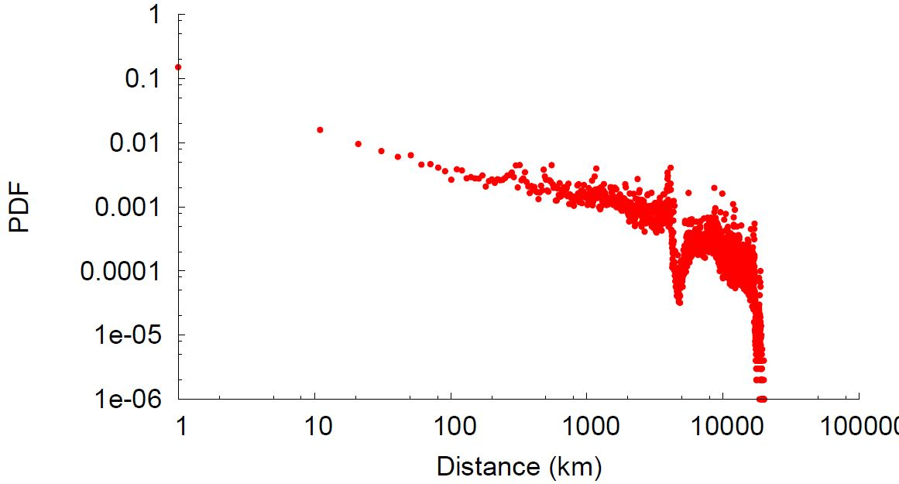



How geographically distributed are the propagation trees?
A
Users within a short geographical distance have a higher probability of posting the same URL
B
C
D
Notes:
In their profile, users have a field where they can write from where they are. We used this information to make a query on Google Geocoding API, and we could get the latitude and longitude coordinates of half of the users on dataset2.
We then measured the distance between each pair of users in the cascade trees. In other words, we measured the distance between the user who tweeted a URL and the user from who he got the URL. These are the red points in the figure. For comparison purposes, we also measured the distance between a user and all of his followers. We called this as the friendship links, showed in the black points in the curve.
We observe that users within a short geographical distance have a higher probability of posting the same URL than those who are physically located farther apart. This information can be useful to OSN providers in several ways. For example, they can use this to improve their infrastructures design and to recommend content.
Interestingly, the correlation between the content propagation probability and the physical proximity is slightly higher than for friendship links. This might be explained by the fact that Twitter users also follow media companies and celebrities.

Slide 38
Summary:
Patterns of URL propagation
Large-scale analysis of URL propagation in Twitter
  All contents have a chance to reach a large audience
  Propagation trees on Twitter are wide and shallow
    Advertising
  Content is consumed locally
    Caching design and recommendation
Notes:
In summary, we presented which we believe is a first large scale analysis of WoM web based content discovery. For example, we showed that [read sentence 1]. If the content is good, indenpendently if it come from a known website or from a new domain, it will spread virally if users like it. We also showed that [read sentence 2]. This is an important information for advertisers, as it shows that it is better to focus on several influent users than only one big user. Another point we showed is that [read sentence 3]. This information is important for OSN providers to improve their infrastructure design and to CDNs.
We also showed other results in the paper which I did not talk about in this talk, but I encourage you to read in the paper.

Slide 39
Microscopic analysis: Understanding news media landscape in Twitter
With Jisun An (Cambridge Univ.)
Meeyoung Cha (KAIST)

Slide 40
Interesting questions
Does social interaction help media sources reach more audience?
Do users follow diverse media sources?
Does social interaction expose users to diverse media sources?
Notes:
Due to the importance of understanding how people discover information in online social media, in this paper we provide a large scale analysis of Word-of-Mouth web based content discovery on Twitter, a popular microblogging service.
We answered several interesting research questions in this some. Some of the questions are: read the questions

Slide 41
Methodology
Focus on 80 media sources
  English-based media
  A total of 14M followers and their connections (1.2B links, 350,000 tweets
Genre | Example account
News (40 sources) | cnnbrk, nytimes, TerryMoran
Technology (13) | BBCClick, mashable
Sports (7) | NBA, nfl
Music (3) | MTV
Politics (5) | nprpolitics,
Business (2) | davos
Fashion & Gossip (4) | peoplemag
Notes:
To answer these questions, we used a twitter dataset previously collected. It’s near complete Twitter data till July 2009. To see how media sources interact with their audience in twitter, we focused on 80 main stream media sources. We selected them manually from the Twitter’s suggestion page as well as a website called who-to-follow. Most of them are English-based media sources and they are categorized in 8 different categories including news, sports and technology. In a news category, not only media outletsm like cnnbrk, nytimes but also individual journalists and anchors like terrymoran are also included.
앞에 말씀드린 질문에 답하기 위해 우리는 트위터 데이터를 이용하였습니다. 어제 차미영 교수님께서 언급하셨던 데이터인데요. 트위터의 시작점인 2006년 부터 2009년 7월 까지의 모든 사용자, 그들 사의 소셜 링크, 트윗들을 포함하고 있습니다. 이 중에서 미디어 소스들이 어떻게 소통하고 있는 지를 확인 하기 위해서 우리는 80개의 main stream media source들에만 초점을 맞추었습니다. 트위터의 추천 페이지와, who=to=follow라는 웹 싸이트를 이용하여 제가 손수 80개의 유명한 미디어 소스들을 선택하였습니다. 대부분이 영어를 주로 이용하는 미디어 소스들이구요, 뉴스, 스포츠, 기술을 토함한 8개의 서로 다른 토픽 그룹에 속해 있습니다.

Slide 42
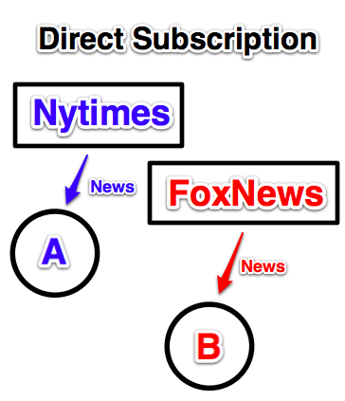
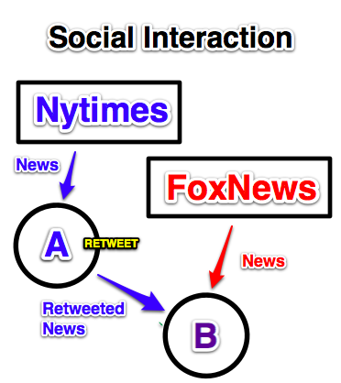


Media exposure
Notes:
Before getting into the result of our analysis, here are some terms that we need to be aware. The figure shows the information flow between media publishers and their audience. When a user follows media sources in Twitter, then we called it as direct subscription. In this figure, nytimes has user A as its audience and user A will received news from nytimes, we called it as exposure by direct subscription.
In addition to direct subscription, users are exposed to additional news by their friends. For example, when user B follows user A, if user A forwards one news from nytimes, then user B is exposed to nytimes. We called it as exposure by ‘social interaction’. In that figure, now we are saying that nytimes has both A and B as its audience.
In the exposure by social interaction, anyone who received at least one news from a media source are regarded as audience of that media source.
결과를 말씀 드리기 전에 앞서 인지하셔야 되는 단어들이 있는데요 잠깐 언급하고 넘어가도록 하겠습니다. 이 그림은 미디어 출간자와 청중들 사이의 정보의 흐름을 보여주고 있습니다. 어떤 한 사용자가 트위터에서 한 미디어 소스를 follow 할 때 우리는 이것은 direct subscription, 즉 직접 구독이라고 부릅니다. 예를 들어 이 그림에서 뉴욕타임즈는 사용자 A를 청중으로 갖고 있고 사용자 A는 뉴욕 타임즈로 부터 뉴스를 받게 되는 데, 사용자의 측면에서 우리는 이것을 직접 구독에 의한 노출이라고 부릅니다.
직접 구독과 더불어 앞서 말씀드렸들이, 사용자들은 이제 자신의 친구들에 의해 뉴스를 받게 되는 데요. 예를 들어 사용자 B가 사용자 A를 follow 할 때, 만약에 사용자 A가 뉴욕타임즈의 뉴스 기사를 하나 retweet을 통해 전달한다면, 이제 사용자 B는 자신이 뉴욕타임즈를 구독하고 있지 않더라도 뉴욕타임즈에 노출되게 되는데요 이것을 우리는 social interaction에 의한 노출이라고 부릅니다. 미디어 출간자의 측면에서 본다면, 뉴욕타임즈는 사용자 A와 B모두를 청중으로 갖게 되는 것이죠. 이것을 간접 청중이라고 부르지 않고 social interaction 청중이라고 부릅니다. 다시 한 번 말씀드리면, social interaction에서는 어떤 사람이 어떤 미디어의 뉴스 기사를 한 번 이상 받게 되면, 그 사용자는 그 미디어의 청중으로 고려 됩니다.

Slide 43
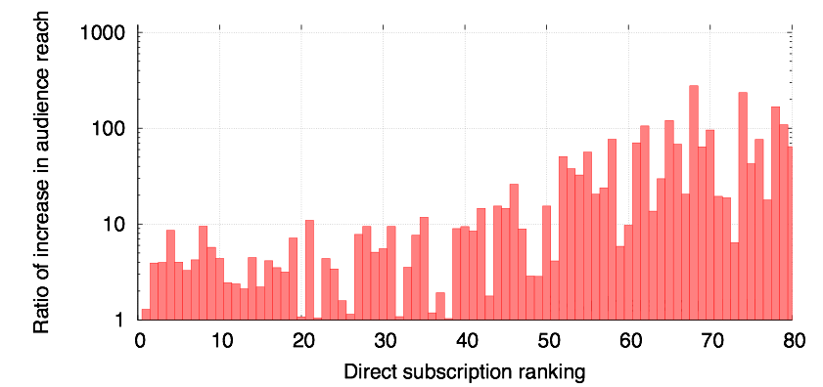
Is social interaction helping media publishers reach more audience?
2. nytimes
1.7M -> 6.7M
65. washingtonpost
30K->3.5M
8. BBCClick
1.2M -> 12M
2. Nytimes
(1.7M)
55. NASA
(120K)
Yes: Social interaction increases publisher’s audience
On average, audience size increases by a factor of 28
Notes:
Back to our question, is social interaction helping reach more audience? Going beyond the direct subscription, how large audience does their news story reach to? Here on the x-axis, it’s ranking of media sources. We ranked media sources based on their number of followers which we called direct subscription. For example nytimes ranked as second and having 1.7M audience and NASA ranked as 55th and having 120K audience. and then in Y-axis, we plotted the increase in their audience size by retweeting or mentioning against to those of direct subscription. On average, size of audience has been increased by factor of 28. For example, nytimes originally has 1.7M audience but by retweeting and mentioned of their audience, they are now exposed to 6.7M users indirectly. As you can see top-ranked media just get fairly enough benefit from the social interaction. But as ranking goes down, there’s tendency ratio of increase is getting higher. It indicates those media sources, which are less popular in terms of their direct audience size, like washington post, have more benefits from social interaction. Now you might understand why media sources are trying to leverage social media to distribute news.
It could be the evidence for some of observations from the other work that people are actually exposed to not only content from the main stream media, but also niche content from smaller media by their friends, so called social filter effect.
그럼 다음 질문으로 넘어와서, 과연 social interaction은 좀 더 많은 청중을 확보할 수 있게 도와줄까요? 직접 구독에 의한 청중을 넘어서 과연 그들의 뉴스 기사는 얼마나 많은 청중들에게 노출이 될까요? 이 그림에서 x축은 각 미디어 소스를 나타내는데, 80개의 미디어 소스들을 그들의 직접 청중 수를 기준으로 정렬하였습니다. 예를 들어 뉴욕타임즈는 2위를 차지하였는데요 1백7천만 청중을 갖고 있구요. NASA는 55위 인데 12만 청중을 갖고 있습니다. 여기에 y축에는 직접 청중에 비하여 소셜 interaction 청중이 몇 배 증가하였는지를 나타내고 있습니다. 다시말해 retweet 이나 mention등을 통해 몇배의 사람들에게 더 노출이 되었는지를 나타냅니다. 평균적으로는 28배 증가하였구요. 상위에 랭크되어있는 미디어 소스들은 그 증가가 크지는 않지만, 보시는 바와 같이 하위에 랭크되어 있는 미디어 소스들, 즉 직접 청중수가 상대적으로 작은 미디어 소스들은 social interaction를 통해 아주 큰 이익을 보고 있는 것을 확인할 수 있습니다. 왜 미디어 소스들이 소셜 미디어를 이용하려고 혈안이 되어 있는지 이해가 되시나요?

Slide 44
Does a user follow multiple media sources?
Direct Subs: 80% users subscribe only to 2-3 media sources
No: Users only follow limited number of media sources.
Notes:
When we look at their direct following links, we can measure how many media sources each user follow among those 80 media sources. This graph shows cumulative distribution function of number of distinct media sources each user subscribe to. Here the graph shows 80% of users follows only to 2-3 media sources. it’s quite smaller than we expected.
이제 데이터에서 사용자들의 미디어 소스들로 향한 follow link들을 들여다 보면, 과연 80개의 미디어 소스들 중에 몇 개나 구독하고 있는지를 세볼 수 있습니다. 이 그래프는 각 사용자가 구독하는 있는 별개의 미디어 소스의 개수에 대한 cumulative distribution function을 나타내고 있는데요. 보시는 바와 같이 80%의 사용자들이 단지 2개 내지에서 3개의 미디어 소스들만을 구독하고 있는 것을 알 수 있습니다. 생각했던 것보다 굉장히 작은 수의 미디어만을 구독하고 있네요.

Slide 45
Is social interaction exposing users to multiple media sources?
Direct Subs: 80% users subscribe only to 2-3 media sources
Social Interaction: 80% of users hear from up to 27 media sources
Yes: 8 fold increase in number of media sources
Notes:
then What could be the impact of social interaction? After incorporating social interaction, they are now hearing from up to 27 media sources. Also I found it surprising that even it’s few, there are some people who get the news from more than 40 media sources, I wonder how they manage to intake the news. While users are actually following to very limited media sources directly, social media gives a chance for users to find some spontaneous news article that they didn't know they are interested in.
자 그렇다면, social interaction의 영향력은 얼마나 될까요? social interaction을 고려해 보면, 이제 사용자들은 무려 27개의 미디어 소스들에 노출되고 있습니다. 저한테는 되게 재미있었던 점이, 잘 보시면 몇 명 되지는 않지만 40개 이상의 미디어 소스들로부터 뉴스를 받게 되는 사용자들이 있는데, 이런 사람들은 그 많은 뉴스 기사들을 어떻게 다 읽고 있을 까 하는 생각이 좀 듭니다. 사용자들은 직접적으로 굉장히 작은 수의 미디어를 구독하는 반면에, 소셜 미디어는 사용자들로 하여금 기존에 자신이 재밌을 거라고 생각하지도 못했던 뉴스나 컨텐츠등을 우발적으로 발견할 수 있는 기회를 제공하고 있습니다.

Slide 46
Does a user follow diverse media sources?
Following multiple media sources
does not necessarily imply
exposure to diverse opinions
Focus on political news
Notes:
However, exposing to multiple media sources doesn't not necessarily mean that users are exposed to diverse media sources. For example, a user might receive news from 10 difference media sources having the same bias, like liberal view point. Thus, we're focusing on political news to measure the opinion diversity since political news can have different point of views, like left, center, or right and we’re asking to what extent users increase opinion diversity through social interaction?
그렇지만, 여러개의 미디어 소스에 노출된다고 하는 것이 꼭 다양한 미디어 소스에 노출된다는 것을 의미하지는 않습니다. 예를 들어 한 사용자가 10개의 다른 미디어 소스들로부터 뉴스를 받지만, 그 10개의 미디어 소스들이 모두 같은 정치적 의견 예를 들면 좌측의 의견만을 반영하고 있을 수도 있지 않나요? 그래서 지금부터는 사용자들의 의견의 다양성을 측정하기 위해 정치적 미디어에만 초점을 맞추었습니다. 정치적 뉴스는 left, center, or right등의 의견을 가질 수 있습니다.

Slide 47
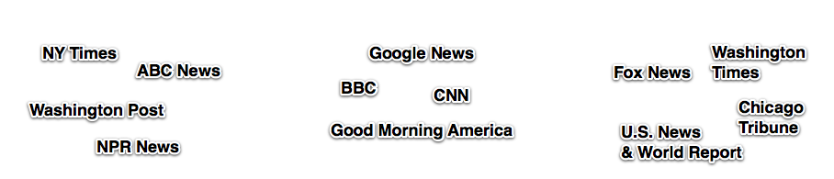
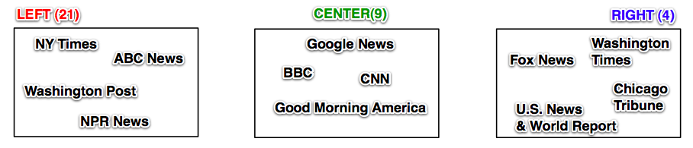
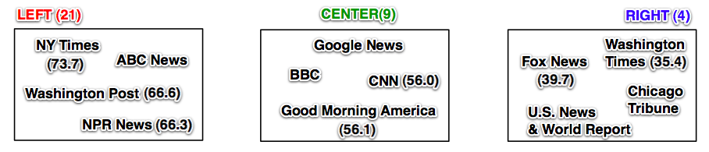
Does user follow diverse media sources?
Manually tagging political leanings of media source
  Left-right.org
  ADA (Americans for Democratic Action) score
  Scale from 0 to 100, where 0 means ‘very conservative’
I like to see diverse media sources
No: Out of 10M users, 7M users only follow one side of media sources
  Left-leaning(62.1%), center (37%), right-leaning (0.9%)
Notes:
we measured how many media sources in different political view point a user follows. Among the 80 media sources we started to study, there are 34 political media source. We manually tagged media sources with their political leanings by referring left-right.org. For those political media sources, 21 media sources are categorized in left wing side, 9 in center and 4 in right wing sdie. then we also referred ADA scores of media outlets to check whether this categorization is validate. In the work named ‘ a measure of media bias in 2005 by Time Groseclose and Jeff Milyo, ADA score is a well known media bias metric that requires extensive text classification techniques. It scales from 0 to 100, where 0 means 'very conservative'. If one follows nytimes and chicago tribuens at the same time, we considered that he likes to see diverse media source. Do people follow diverse media sources? Interestingly, out of 10M users, 7M users are following only one side of media sources! one feature of our dataset is that there are overwhelming left-leaning media sources thus our dataset has majority of left leaning population. Despite these limitations, we belive that our results provide a valuable snapshot of the media landscape at an early stage of Twitter.
이제는 사용자가 단순히 몇개의 미디어를 follow하고 있느냐가 아닌, 몇개의 다른 정치적 의견에 대해 follow 하고 있느냐를 측정하였습니다. 이를 위해 다음과 같은 방법을 사용하였는데요. 80개의 미디어 소스들 중에 34개가 정치적 뉴스를 다루는 미디어였구요. left-right.org이라는 싸이트등을 이용하여 이 34개의 미디어의 정치적 편향을 결정하였습니다. 21개가 left, 9개가 center, 4개가 right을 차지하였습니다. 기존의 미디어 정치적 편향 연구 중에 2005년에 각 미디어의 ADA score를 매긴 연구가 있었는데요. 이 ADA score는 0부터 100까지 범위에서 0은 very conservative 를 의미합니다. 이 점수를 매기기 위해서는 미디어들의 모든 뉴스 기사를 모아서 기사에 사용된 단어들을 이용하게 되는데요, 필요한 데이터량도 많고 시간이 오래 걸립니다. 어쨌든 기존의 ADA score 역시 categorization과 매칭이 되는 것을 볼 수 있습니다. 여기서 어떤 사용자가 다양한 미디어 소스를 본다는 것은 예를 들어 어떤 사용자가 left 측에 있는 뉴욕타임즈와 right 측에 있는 chicago tribune을 같이 follow 하는 경우를 말하고 있습니다. 그럼 과연 사람들은 다양한 미디어 소스들을 follow하고 있을까요? 재미나게고 34개의 미디어 소스를 구독하는 1천만명의 사용자들 중에 무려 7백만명의 사용자가 단 한 쪽의 미디어 소스들 만을 따르고 있었습니다.

Slide 48
Is social interaction exposing users to diverse media sources?
Yes: Users are exposed to diverse opinions through social interaction
Notes:
then we are back to our question. is social interaction helping them to receive diverse opinions? the answer is yes. 17.8% of left wing users and 57.2% of right wing users are exposed to opposite view point by their friends. again, the numbers in our result might have been influenced by left-leaning dominated population of our dataset. Maybe it's not significant exposure but it is worth to know there's potential for social media to help them to get balanced view.
그렇다면, social interaction이 좀 더 다양한 의견을 전달받게 해 줄까요? 정답은. 네 맞습니다. 17.8%의 left 쪽의 사용자들, 57.2%의 right 쪽 사용자들의 자신의 친구들을 통해 자신이 구독하고 있는 의견과 상반되는 미디어에 노출되고 있었습니다. 물론 이것이 굉장히 주목할 만한 노출 정도가 아닐 수도 있지만, 소셜 미디어가 사용자들로 하여금 균형된 의견을 받게 하는 잠재성을 갖고 있다는 것을 확인한 것에 의의가 있다고 생각합니다.

Slide 49



Estimating closeness
How “close” or “similar” two media sources are
Notes:
From the observation that users are following multiple media sources in the same political leaning, we had this feeling that it's possible to utilize this overlap between two media sources to measure how "close" or "similar" two media sources are.
우리는 많은 사용자들이 같은 정치적 의견에 있는 여러개의 다른 미디어 소스들을 한꺼번에 follow 하고 있는 것을 발견하였는데요. 이를 통해, 어떤 두 미디어 소스의 공통된 청중이 이 두 미디어 소스들이 얼마나 가까운지 또는 유사한지를 측정할 수 있지 않을까 하는 생각을 하기 시작했습니다.

Slide 50
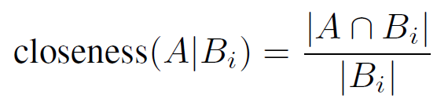
Closeness measure
NYTimes (A)
NYTimes (A)
Foxnews (B₁)
washingtonpost(B₂)
2,947,635
142,951
435,222
2,840,960
249,626
154,224
Which one is closer to nytimes, Foxnews or washingtonpost?
Washingtonpost is closer to nytimes than Foxnews
Closeness: probability that a random follower of B_{i} also follows A
Closeness( NYTimes, Foxnews) = 143K/578K = 0.25
Closeness( NYTimes, washingtonpost) = 250K/404K = 0.62
Notes:
Here is one case. Which one is closer to nytimes, CNN or wired?
We defined this asymmetric 'closeness measure' that simply normalizes an overlap in their audience.
Given a media source A, closeness of media source B is defied as interaction size of their audience divided by audience size of media source B.
From this equation, given a nytimes, the closeness of cnn is 0.29 which means there are 29% of change that a random follower of CNN also follows nytimes.
Given a nytimes, the closeeness of wired is 0.67 which is higher than closeness of cnn.
We can now say wired is closer to nytimes than CNN.
This closeness measure is ego-centric. even wired is closer to nytimes than CNN, it doesn’t define the relation between CNN and wired.
But is this metric useful? Where can we use this metric? Here is one example
여기 뉴욕타임즈와 폭스 뉴스 그리고 워싱턴포스트의 예가 있습니다. 폭스 뉴그와 워싱턴포스트 둘 중에 누가 더 뉴욕타임즈에 가까울까요?
이를 위해 단방향성 closeness measure (친밀도) 를 정의하였는데요 이것은 간단하게 두 미디어 사이의 공통 청중을 normalize 하였습니다.
어떤 미디어 소스A가 주어졌을 때, 미디어 소스 B에 대한 가까운 정도는 두 미디어 사이의 공통 청중의 수 나누기 미디어B의 청중 사이즈 입니다. 결국 이것은 어떤 랜덤한 B의 청중이 미디어 A를 follow할 확률을 의미하게 됩니다. 뉴욕 타임즈가 생각하는 폭스 뉴스에 대한 친밀도는 0.25구요 워싱턴 포스트에 대한 친밀도는 0.62 입니다. 즉 워싱턴 포스트가 폭스 뉴스보다 뉴욕 타임즈에 더 가까운 미디어인 것을 말하고 있습니다. (잠깐 언급하자면 폭스 뉴스는 right side이고 워싱턴포스트는 left side 입니다. ) 여기에서 정의한 친밀도는 단반향성이기 때문에, 워싱턴 포스트가 폭스 뉴스보다 뉴욕타임즈와 더 가깝다고 해서 이것이 워싱턴 포스트와 폭스 뉴스 둘 사이의 관계를 정의하지는 않습니다.
그렇다면 이 척도가 과연 유용할까요? 과연 이게 어디에 쓰일 수 있을까요? 여기 한가지 예가 있습니다.

Slide 51
Closeness of political media sources
Picked political media sources
Ranked other political media sources based on closeness value
nprpolitics (Left)
washtimes (Right)
washingtonpost (Left) foxnews (Right)
usnews (Right)
bbcbreaking (Center)
earlyshow (Left)
nytimes (Left)
arianhuff (Left)
ObamaNews (Left)
nprpolitics (Left)
close
nytimes (Left)
jdickerson (Left)
Nightling (Left)
nrpscottsismon (Left)
GMA (Center)
bbcbreaking (Center)
foxnews (Right)
washtimes (Right)
close
distant
distant
We can automatically infer political leaning of media sources
Notes:
We picked one of political media sources, nprpolitical which is considered as left-wing media. and then we ranked the other political media sources based on their closeness values to the nprpoliticss. And here’s the political leaning of each media source. As you can see, they are lined up very well from extreme to the other extreme. This map shows that nytimes is the closest media to nprpolitics and jdickerson is the second closest media source, and so on. but again, it does not necessarily means nytimes is the cloest media source to jdickerson. And here is the another example of washtimes. result also shows political dichotomy of media sources. One exception occurs between washtimes and washingtonpost. We conjecture it’s because of regional reason. People in DC might follow them both to get more local news. While the closeness measure shows political closeness,
it can also show the regional closeness.
While these are two of examples, we did simple evaluation for our metric. With a comparison to ADA score, our map got 77.5% matching probability and For the left-wind media sources, it gave perfect match. For the detail, please check the paper. The most interesting implication here is that we can automate whole process to infer the political leaning of media sources. The ADA scores requires lots of manual effort including collecting much articles from each news outlet and expensive text classification algorithm to determine the leaning. Also while there are only 25 media outlets having ADA score, it’d be possible to pursue large-scale study with our metric to get the bias score of any media source. or through a repeated study overtime, we might be able to see the evolution of political media map .
정치적 미디어 들 중 left 측으로 구분되는 nprpolitics라는 것을 하나 골라내었습니다. 그리고 나머지 정치적 미디어들에 대해 각각 친밀도를 구하고, 그 값을 기준으로 정렬하였습니다. 그리고 여기 각 미디어 소스들의 정치적 성향이 있습니다. 보시는 바와 같이, 친밀도를 통한 정렬일 뿐인데 정치적 성향 또한 한쪽 극에서 다른 쪽 극으로 잘 정렬이 되어있는 것을 보실 수 있습니다. 여기 또 다른 예가 있는데요, right 측으로 구분되는 washtimes 입니다. 역시나 정치적 양분을 보여주는 데요, 한가지 예외적인 사항이 washtimes 와 washingtonpost 사이에서 일어납니다. 추측컨데, 두 미디어가 같은 지역 기반이기 때문에 워싱턴에 사는 사람들이 로컬 뉴스를 확인하기 위해서 양 쪽 모두 follow 하고 있는게 이유이지 않을까 생각됩니다. 이렇게 친밀성 척도는 정치적 경향 뿐만 아니랑 지역적 친밀성 등도 나타낼 수 있습니다.
이 예제에서 재미난 점은 미디어의 정치적 편향성을 추측하는 이 전체의 과정을 자동화 할 수 있다는 것입니다. 앞서 말씀드린 ADA score와 같은 정지적 편향 연구에서보면 각 미디어의 뉴스 기사들을 모두 모으고, 비싼 text classifcation 알고리즘을 이용했어야 하는데, 여기에서는 사용자들의 구독 link만을 가지고 비슷한 결과를 얻어낼 수 있습니다. 또한 앞 선 연구에서 25개의 미디어 만을 대상으로 한 것에 비해, 이런 친밀도를 이용하면 훨씬 더 큰 규모의 연구가 가능하고 또한 시간의 변화에 따라 미디어 들의 정치적 성향이 어떻게 변화하는 지에 대한 연구도 가능하게 됩니다.

Slide 52
Summary: Media landscape in Twitter
Users only follow limited number of media sources.
But they are exposed to 8x more media sources via social interaction
Most users only follow political media with a certain bias
Can automatically infer bias in media sources
  Could be used for recommending content from diverse media sources

Slide 53
Emergence of social conventions
With Farshad Kooti (MPI-SWS)
Meeyoung Cha (KAIST)
Winter Mason (Stevens Inst. of Tech.)

Slide 54
Interesting questions
How do social conventions arise naturally?
What is the context of their invention?
How do they become widely accepted?
Can we predict their adoption?

Slide 55
The retweeting variations
Searched for syntax
token @username
“Adopter” refers to a user using the variation at least once
Variation | # of adopters | # of retweets
RT | 1,836 K | 53,221 K
via | 751 K | 5367 K
Retweeting | 50 K | 296 K
Retweet | 36 K | 110 K
HT | 8 K | 22 K
R/T | 5 K | 28 K
♻ | 3 K | 18 K
Total | 2,059 K | 59,065 K
Notes:
Currently on Twitter we have a retweet button that many of the users use that. But, this feature was added to Twitter in late 2009, after our dataset was crawled. But, before that users were retweeting by using the pattern of token @username. @username is the way that one can mention a user on Twitter. After we extracted all the such tokens from all our tweets, we manually selected the ones which were used for retweeting. And among them, we selected the 4 most popular tokens and 3 moderately popular tokens. Also, in our work adoption refers to using a variation at least once.
In this table on the rate, you can see all the variations ordered by their number of adopters. The most popular variation is RT with 1.8 M adopters and 53 M retweets. The next one is via with 750 adopters and more than 5 M retweets. The next variations have considerably less adopters. The next variation is Retweeting, and then Retweet, HT, R/T and the recycling symbol. And in total we have more than 2 M users who used any of these variations and almost 60 usages.
Transition: For these 7 variations ...

Slide 56
Why retweeting convention?
Information-sharing channels are explicit in Twitter
Specific to Twitter: exposures within the community
Contained in Twitter, hence capturing all usages
Notes:
There are several reasons why we chose to study the retweeting convention.
First, the conventions is used on Twitter and in Twitter information sharing channels are explicit. These are the follow links that we have on Twitter.
Moreover, the convention is specific to Twitter. So, this lets us to study an almost closed system which means that users are getting exposed from within the community and also we
And when I talk about all usages I mean all usages
Okay, so we’re focusing on retweeting convention.
The chance to pick it up from somewhere else is almost zero and the percentage

Slide 57
What are the very first use cases?
HT
Oct’07
Retweeting
Jan’08
R/T
Jun’08
Via
Mar’07
Retweet
Nov’07
RT
Jan’08
♻
Sep’08
Notes:
Here you can see a timeline from the introduction of the first variation in March 2007 till the last one in September 2008.
Now, I’ll go over each variation and talk about the very first usage of it.
So, ...

Slide 58
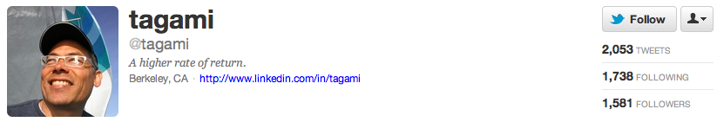
Via started from natural language
@JasonCalacanis (via @kosso) - new Nokia N-Series phones will do Flash, Video and YouTube
HT
Oct’07
Retweeting
Jan’08
R/T
Jun’08
Via
Mar’07
Retweet
Nov’07
RT
Jan’08
♻
Sep’08
Notes:
The first variation is via, that was introduced in March 2007, 1 year after Twitter was launched.
So, “via” is a common word in English and some European languages and it somehow makes sense that the user uses that so that his audience understands it. So, via came in Twitter from natural language.

Slide 59
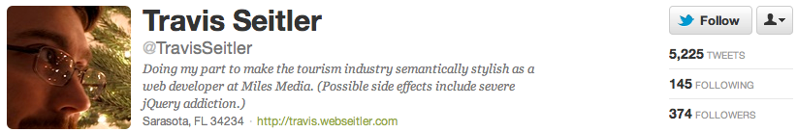
HT started from blog communities
The Age Project: how old do I look? http://tweetl.com/21b ( HT @technosailor )
HT
Oct’07
Retweeting
Jan’08
R/T
Jun’08
Via
Mar’07
Retweet
Nov’07
RT
Jan’08
♻
Sep’08
Notes:
The next variation is HT which stand for Hear Through or Hat Tip. HT was used earlier by bloggers for showing respect to someone or mentioning the source of their post. And here the user thought we have the same idea, so he used HT. So, HT came in Twitter from another community.

Slide 60
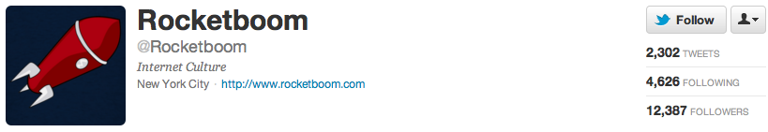
The first Twitter-specific variation
Retweet @HealthyLaugh she is in the Boston Globe today, for a Stand up show she’s doing tonight. Add the funny lady on Tweeter!
HT
Oct’07
Retweeting
Jan’08
R/T
Jun’08
Via
Mar’07
Retweet
Nov’07
RT
Jan’08
♻
Sep’08
Notes:
The next variation is Retweet. Retweet is the first Twitter-specific variation because it has the word tweet in it. So, users won’t know what it means unless they know what Twitter and tweet are.

Slide 61
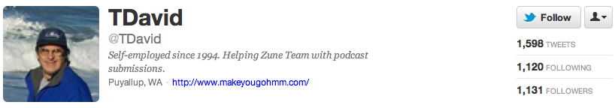
RT was an adaption to constraints
RT @BreakingNewsOn: "LV Fire Department: No major injuries and the fire on the Monte Carlo west wing contained east wing nearly contained."
HT
Oct’07
Retweeting
Jan’08
R/T
Jun’08
Via
Mar’07
Retweet
Nov’07
RT
Jan’08
♻
Sep’08
Notes:
And then, in January 2008, RT, which is ultimately the most popular variation, was introduced. Interestingly, the user who posted the tweet has used the Retweet variation earlier and also this first tweet of RT contains exactly 140 character. Which means the user couldn’t fit the whole variations and decided to adapt the variation to the space limit in Twitter. So, RT was a previous variation adapted to the constraints of the social environment.

Slide 62
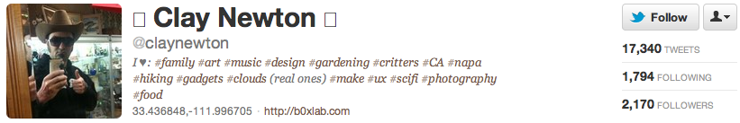
Some start from explicit discussions
♻ @ev of @biz re: twitterkeys ★ http://twurl.nl/fc6trd
HT
Oct’07
Retweeting
Jan’08
R/T
Jun’08
Via
Mar’07
Retweet
Nov’07
RT
Jan’08
♻
Sep’08
Notes:
And finally in September 2008 the last variation, recycling symbol, was introduced. We saw that all previous variations were introduced naturally but recycle symbol was explicitly introduced to improve the retweeting better. It was introduced by Evan Williams and Biz Stone, co-founders of Twitter. But at the end it’s the least popular variation among the 7 variation. Probably because it’s hard to generate.
Most cases naturally, here explicit
Post by Biz Stone, tweeted by Evan Williams

Slide 63
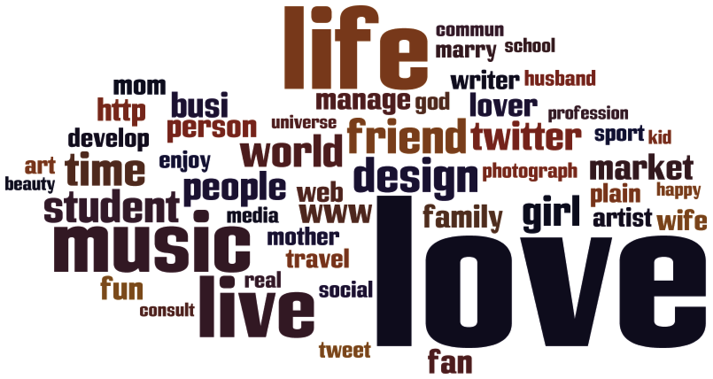
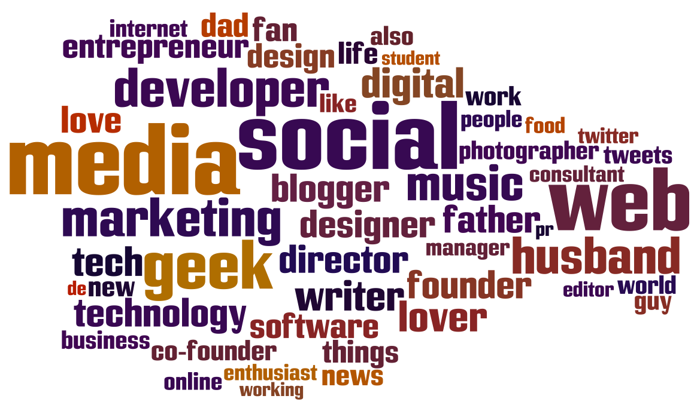
Early adopters are more tech-savvy
Random users
Early adopters

Slide 64
Early adopters are more innovative
 | Early adopters | Random users
Has Bio | 94% | 25%
Profile Pic | 99% | 50%
Changed profile theme | 91% | 40%
Has Location | 95% | 36%
Has Lists | 57% | 4%
Has URL | 85% | 14%
Notes:
So, in this section I’m presenting the results for first 1000 adopters, but the results remains very similar if we pick other thresholds like 500 or 100.
Let’s first compare profiles of early adopters with a random sample of users.
This table shows different features of Twitter that a user can use. Like adding a bio to the profile, having a profile picture, and so on. We can see early adopters are using all of these features much more than the random sample.
This means they’re using more of Twitter features and these users are in general innovative and tech-savvy.

Slide 65
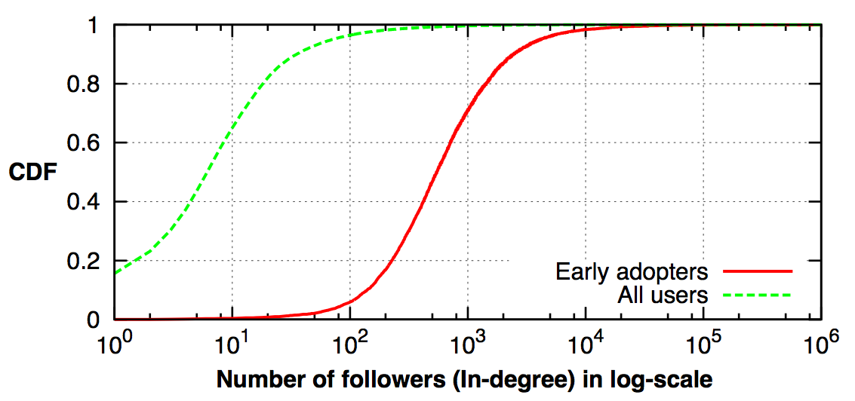
Early adopters are more popular
Much higher number of followers
80% of early adopters in top 1% based on PageRank
Notes:
Okay, now let’s see how popular the early adopters are. Here we can see the the CDF of in-degree or number of followers of early adopters and all users. X-axis is an specific degree and it’s in log-scale and Y-axis value for a given degree, shows the fraction of users with that degree or smaller degree.
We see that early adopters have 2 orders of magnitudes more followers than all users.
We also looked at their page rank and 80% of early adopters are ranked in top 1% of whole Twitter users according to the page rank.
So, early adopters are popular and influential users.

Slide 66
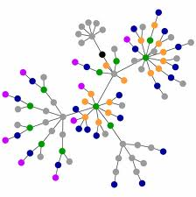
Defining the diffusion network
Each adopter is a node in the graph.
There is a link from A to B if A was exposed to the variation by B.
Notes:
Next, let’s see how the diffusion process was in the early stages. For this, we generate a diffusion network from the adopters.
In diffusion network we represent each adopter with a node and there is a link from user A to user B if user A was exposed to the variation by user B. This means user A is a follower of user B in Twitter and also user B used the variation before A. This doesn’t mean B has necessarily influenced A, but it’s likely that
e.g., here you can see the diffusion network of first 500 adopters of RT. We can see the graph is pretty dense and clustered.

Slide 67
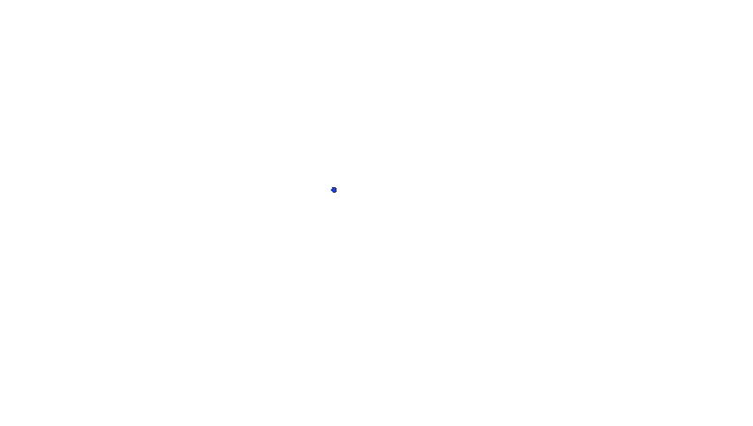
Diffusion network of first 500 adopters of Retweet

Slide 68
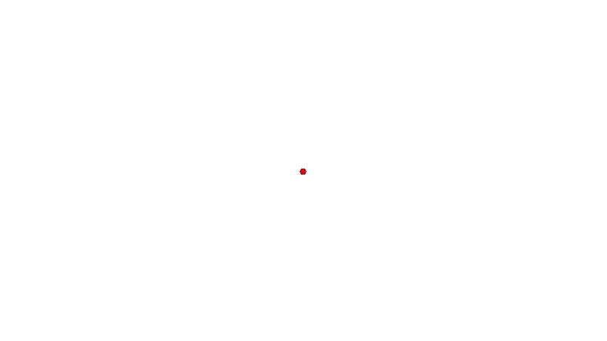
Diffusion network of first 500 adopters of RT

Slide 69
Early adopter network
Average number of exposures: 2.9 – 6.4
Average clustering coefficient: 0.233 - 0.320
  Criticality: fraction of users who were only exposed because of the most critical user: 0.5% - 4.9%
Early adopters’ diffusion networks are dense and clustered. There is no single critical user.
Notes:
So, we generated this diffusion network for first 1000 adopters of each variation and observed couple of its characteristics. First, we looked at average number of links in each network. Remember that each link represents an exposure and possibility of influence. The average number of links is ranged from 2.9 up to 6.4. Which means each, on average, each adopter have been exposed by 3 other users before adopting the variation, which is very high and also have in mind that this exposure only comes from 1000 users.
Next we looked at the clustering coefficient and it ranges from 0.223 to 0.320. In general, clustering coefficient of larger than 0.2 considered to be high, so the networks are clustered. And finally, we wanted to see if there is a single node that is critical in the diffusion process of early adopters. For this, we defined a measure called criticality. Criticality is the fraction of users in the network who were exposed to the variation only because of that user. We calculated the criticality of all users in each network, and the maximum in each network ranges from 0.5% to 4.9%. Which shows there is no critical node.
Okay so diffusion networks of early adopters are dense and clustered and there is no single critical user. And interestingly, this is very different from the diffusion of information, something like URL propagation. Earlier studies showed that the diffusion networks for them are sparse graphs so they’re not dense nor clustered and there are many cases that the there are single nodes who are responsible for exposing large fraction of users.
Clarify this is across different variations
Clustering coefficient of a typical user

Slide 70
Convention had different spread patterns from the URLs
URLs’ early adopters are not necessarily core users
The diffusion network is not dense and clustered
There are critical users in the process

Slide 71
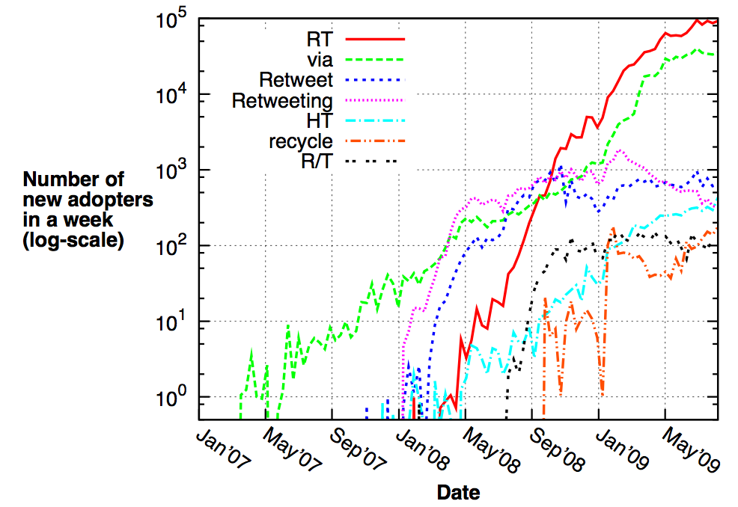
Notes:
Mention the log-scale
Stress that it’s not accumulative
Remove first point
RT/via growth say NEW users
At the end: RT via growing are accelerating and the growth is decalarting
Gap: orders of magnitude
Transition: we see that in the number followers

Slide 72
Some variations are growing and some dying at the end
Variations have different growth rates
Only two variations became dominant
RT
via
Notes:
Mention the log-scale
Stress that it’s not accumulative
Remove first point
RT/via growth say NEW users
At the end: RT via growing are accelerating and the growth is decalarting
Gap: orders of magnitude
Transition: we see that in the number followers

Slide 73
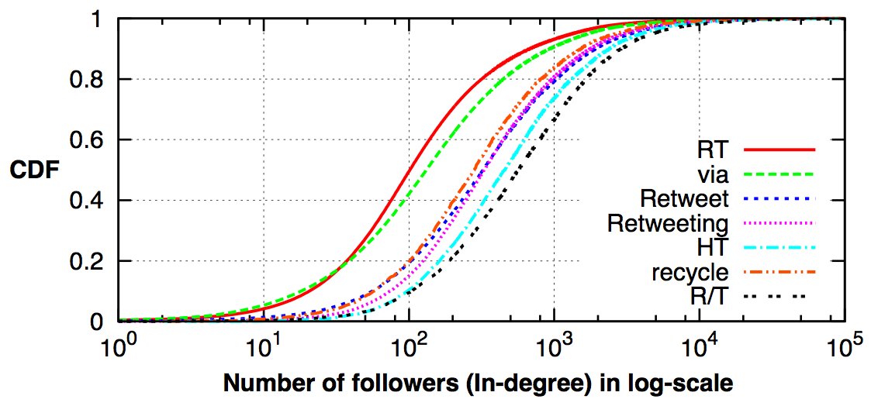
Wide-spread vs. normal adoptions
Successful variations reached peripheral users
In tune with two-step flow theory
Notes:
Remember: two-step flow k Paul Lazarsfeld 1944:
Opinion leaders <- early adopters

Slide 74

Summary
Conventions emerged in an organic, bottom-up manner
Early adopters are core members of the community: Active, tech-savvy, popular, and innovative
Social conventions start spreading through dense and clustered networks and there is no critical user
When variations got popular, they reached out side of core community
Notes:
Twitter is a good source.
First point: say the process of origins
Second point: opinion leaders
Third point: it’s different from information diffusion

Slide 75
Ongoing work:
Convention prediction problem
“Given a social network with records of users and their interactions, how reliably can we infer which variant of the convention a user U adopts at time T?”

Slide 76
Ongoing work:
What features matter for prediction?
Personal features
  join date, in-/out-degrees, geo-location, # of tweets etc.
Social features
  number of exposures, number of adopter friends
Global features
  date of adoption, which is related to global popularity

Slide 77
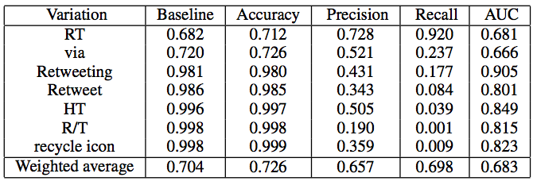
Preliminary results:
Prediction accuracy
Baseline predicts adoption of dominant convention all the time
Minimal improvement in prediction accuracy over baseline

Slide 78
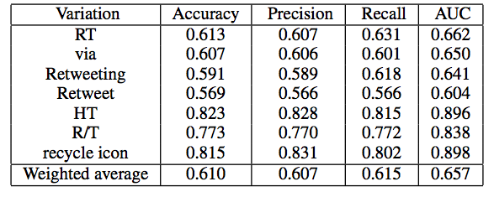
Preliminary results:
Prediction accuracy without a dominant convention
Baseline predicts adoption with 0.5 accuracy
Improvement in prediction accuracy over baseline
  especially, for less popular conventions

Slide 79
Top-5 predictive features
Date of adoption: Global feature
# of exposures: Social feature
# of posted URLs: Personal feature
Join date of adopter: Personal feature
# of adopter friends: Social feature

