Slide 1
Representation and Learning in Directed Mixed Graph Models
Ricardo Silva Statistical Science/CSML, University College London
ricardo@stats.ucl.ac.uk
Networks: Processes and Causality, Menorca 2012

Slide 2
Graphical Models
Graphs provide a language for describing independence constraints
Applications to causal and probabilistic processes
The corresponding probabilistic models should obey the constraints encoded in the graph
Example: P(X₁, X₂, X₃) is Markov with respect to if X₁ is independent of X₃ given X₂ in P( ⋅ )
X₁
X₂
X₃

Slide 3
Directed Graphical Models
X₁
X₂
U
X₃
X₄
X₂ X₄
X₂ X₄ | X₃
X₂ X₄ | {X₃, U}
...

Slide 4
Marginalization
X₁
X₂
U
X₃
X₄
X₂ X₄
X₂ X₄ | X₃
X₂ X₄ | {X₃, U}
...

Slide 5
Marginalization
X1
X2
X3
X4
?
No: X₁ X₃ | X₂
X1
X2
X3
X4
?
No: X₂ X₄ | X₃
X1
X2
X3
X4
?
OK, but not ideal
X₂ X₄

Slide 6
The Acyclic Directed Mixed Graph (ADMG)
X₁
X₂
X₃
X₄
“Mixed” as in directed + bi-directed
“Directed” for obvious reasons
See also: chain graphs
“Acyclic” for the usual reasons
Independence model is
Closed under marginalization (generalize DAGs)
Different from chain graphs/undirected graphs
Analogous inference as in DAGs: m-separation
(Richardson and Spirtes, 2002; Richardson, 2003)

Slide 7
Why do we care?
Candidate I
Candidate II
latent
X₁
X₂
X₁
X₃
X₂
Y₁
Y₃
Y₆
Y₄
Y₁
Y₃
Y₆
Y₂
Y₂
observed
Y₄
Y₅
Y₅
Difficulty on computing scores or tests
Identifiability: theoretical issues and implications to optimization

Slide 8
Why do we care?
X
X₁
X₂
X₃
X₄
X₅
X∞
Y₁
Y₂
Y₃
Y₄
Y₅
Y₆
Set of “target” latent variables X (possibly none), and observations Y
Set of “nuisance” latent variables X∞
With sparse structure implied over Y

Slide 9
Why do we care?
(Bollen, 1989)

Slide 10
The talk in a nutshell
The challenge:
How to specify families of distributions that respect the ADMG independence model, requires no explicit latent variable formulation
How NOT to do it: make everybody independent!
Needed: rich families. How rich?
Main results:
A new construction that is fairly general, easy to use, and complements the state-of-the-art
Exploring this in structure learning problems
First, background:
Current parameterizations, the good and bad issues

Slide 11
The Gaussian bi-directed model

Slide 12
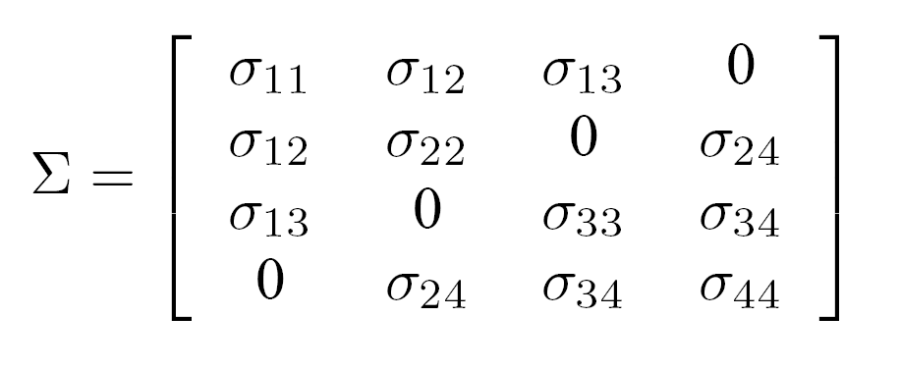
The Gaussian bi-directed case
(Drton and Richardson, 2003)

Slide 13
Binary bi-directed case: the constrained Moebius parameterization
(Drton and Richardson, 2008)

Slide 14
Binary bi-directed case: the constrained Moebius parameterization
Disconnected sets are marginally independent. Hence, define q_{A} for connected sets only
P(X₁ = 0, X₄ = 0) = P(X₁ = 0)P(X₄ = 0)
q₁₄ = q₁q₄
However, notice there is a parameter q₁₂₃₄

Slide 15
Binary bi-directed case: the constrained Moebius parameterization
The good:
this parameterization is complete. Every single binary bi-directed model can be represented with it
The bad:
Moebius inverse is intractable, and number of connected sets can grow exponentially even for trees of low connectivity
...
...
...
...

Slide 16
The Cumulative Distribution Network (CDN) approach
Parameterizing cumulative distribution functions (CDFs) by a product of functions defined over subsets
Sufficient condition: each factor is a CDF itself
Independence model: the “same” as the bi-directed graph... but with extra constraints
F(X₁₂₃₄) = F₁(X₁₂)F₂(X₂₄)F₃(X₃₄)F₄(X₁₃)
X₁ X₄
X₁ X₄ | X₂
etc
(Huang and Frey, 2008)

Slide 17
The Cumulative Distribution Network (CDN) approach
Which extra constraints?
Meaning, event “X₁ ≤ x₁” is independent of “X₃ ≤ x₃” given “X₂ ≤ x₂”
Clearly not true in general distributions
If there is no natural order for variable values, encoding does matter
X₁
X₂
X₃
F(X₁₂₃) = F₁(X₁₂)F₂(X₂₃)

Slide 18
Relationship
CDN: the resulting PMF (usual CDF2PMF transform)
Moebius: the resulting PMF is equivalent
Notice: q_{B} = P(X_{B} = 0) = P(X_{\B} ≤ 1, X_{B} ≤ 0)
However, in a CDN, parameters further factorize over cliques
q₁₂₃₄ = q₁₂q₁₃q₂₄q₃₄

Slide 19
Relationship
Calculating likelihoods can be easily reduced to inference in factor graphs in a “pseudo-distribution”
Example: find the joint distribution of X₁, X₂, X₃ below
P(X = x) =
Z₁
Z₂
Z₃
X₁
X₂
X₃
reduces to
X₁
X₂
X₃

Slide 20
Relationship
CDN models are a strict subset of marginal independence models
Binary case: Moebius should still be the approach of choice where only independence constraints are the target
E.g., jointly testing the implication of independence assumptions
But...
CDN models have a reasonable number of parameters, for small tree-widths any fitting criterion is tractable, and learning is trivially tractable anyway by marginal composite likelihood estimation (more on that later)
Take-home message: a still flexible bi-directed graph model with no need for latent variables to make fitting tractable

Slide 21
The Mixed CDN model (MCDN)
How to construct a distribution Markov to this?
The binary ADMG parameterization by Richardson (2009) is complete, but with the same computational difficulties
And how to easily extend it to non-Gaussian, infinite discrete cases, etc.?

Slide 22
Step 1: The high-level factorization
A district is a maximal set of vertices connected by bi-directed edges
For an ADMG G with vertex set X_{V} and districts {D_{i}}, define where P(⋅) is a density/mass function and pa_{G}(⋅) are parent of the given set in G

Slide 23
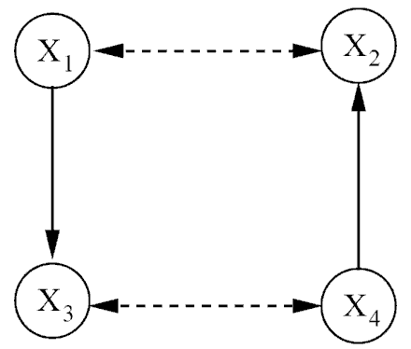
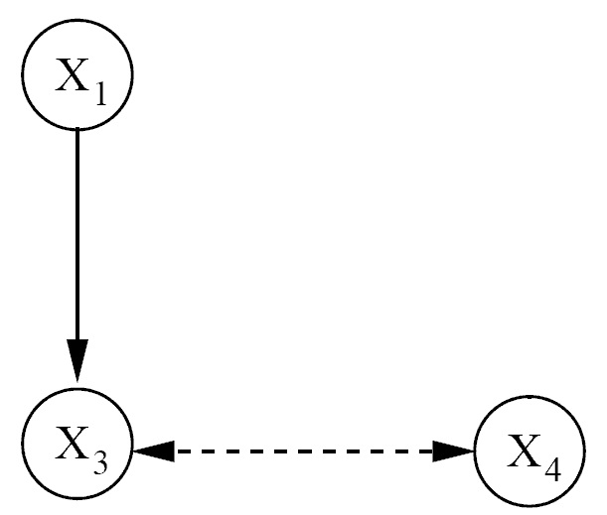
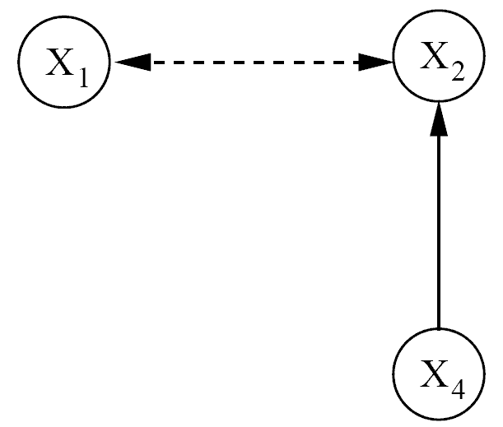
Step 1: The high-level factorization
Also, assume that each P_{i}(⋅ | ⋅) is Markov with respect to subgraph G_{i} – the graph we obtain from the corresponding subset
We can show the resulting distribution is Markov with respect to the ADMG
X₄ X₁
X₄ X₁

Slide 24
Step 1: The high-level factorization
Despite the seemingly “cyclic” appearance, this factorization always gives a valid P(⋅) for any choice of P_{i}(⋅ | ⋅)
P(X₁₃₄) = Σ_{x2}P(X₁, x₂ | X₄)P(X₃, X₄ | X₁)
≡ P(X₁ | X₄)P(X₃, X₄ | X₁)
P(X₁₃) = Σ_{x4}P(X₁ | x₄)P(X₃, x₄ | X₁)
= Σ_{x4}P(X₁)P(X₃, x₄ | X₁)
≡ P(X₁)P(X₃ | X₁)

Slide 25
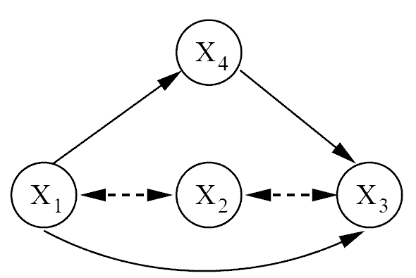
Step 2: Parameterizing P_{i} (barren case)
D_{i} is a “barren” district is there is no directed edge within it
Barren
NOT Barren

Slide 26
Step 2: Parameterizing P_{i} (barren case)
For a district D_{i} with a clique set C_{i} (with respect bi-directed structure), start with a product of conditional CDFs
Each factor F_{S}(x_{S} | x_{P}) is a conditional CDF function, P(X_{S} ≤ x_{S} | X_{P} = x_{P}). (They have to be transformed back to PMFs/PDFs when writing the full likelihood function.)
On top of that, each F_{S}(x_{S} | x_{P}) is defined to be Markov with respect to the corresponding G_{i}
We show that the corresponding product is Markov with respect to G_{i}

Slide 27
Step 2a: A copula formulation of P_{i}
Implementing the local factor restriction could be potentially complicated, but the problem can be easily approached by adopting a copula formulation
A copula function is just a CDF with uniform [0, 1] marginals
Main point: to provide a parameterization of a joint distribution that unties the parameters from the marginals from the remaining parameters of the joint

Slide 28
Step 2a: A copula formulation of P_{i}
Gaussian latent variable analogy:
U ~ N(0, 1)
U
X₁ = λ₁U + e₁, e₁ ~ N(0, v₁)
X₂ = λ₂U + e₂, e₂ ~ N(0, v₂)
X₁
X₂
Parameter sharing
Marginal of X₁: N(0, λ₁² + v₁)
Covariance of X₁, X₂: λ₁λ₂

Slide 29
Step 2a: A copula formulation of P_{i}
Copula idea: start from then define H(Y_{a}, Y_{b}) accordingly, where 0 ≤ Y* ≤ 1
H(⋅, ⋅) will be a CDF with uniform [0, 1] marginals
For any F_{i}(⋅) of choice, U_{i} ≡ F_{i}(X_{i}) gives an uniform [0, 1]
We mix-and-match any marginals we want with any copula function we want
F(X₁, X₂) = F( F₁⁻¹(F₁ (X₁)), F₂⁻¹(F₂ (X₂)))
H(Y_{a}, Y_{b}) ≡ F( F₁⁻¹(Y_{a}), F₂⁻¹(Y_{b}))

Slide 30
Step 2a: A copula formulation of P_{i}
The idea is to use a conditional marginal F_{i}(X_{i} | pa(X_{i})) within a copula
Example
Check:
X₁
X₂
X₃
X₄
U₂(x₁) ≡ P₂(X₂ ≤ x₂ | x₁)
U₃(x₄) ≡ P₂(X₃ ≤ x₃ | x₄)
P(X₂ ≤ x₂, X₃ ≤ x₃ | x_{1,} x₄) = H(U₂(x₁), U₃(x₄))
P(X₂ ≤ x₂ | x_{1,} x₄) = H(U₂(x₁), 1) = H(U₂(x₁))
= U₂(x₁) = P₂(X₂ ≤ x₂ | x₁)

Slide 31
Step 2a: A copula formulation of P_{i}
Not done yet! We need this
Product of copulas is not a copula
However, results in the literature are helpful here. It can be shown that plugging in U_{i}^{1/d(i)}, instead of U_{i} will turn the product into a copula
where d(i) is the number of bi-directed cliques containing X_{i}
Liebscher (2008)

Slide 32
Step 3: The non-barren case
What should we do in this case?
Barren
NOT Barren

Slide 33
Step 3: The non-barren case

Slide 34
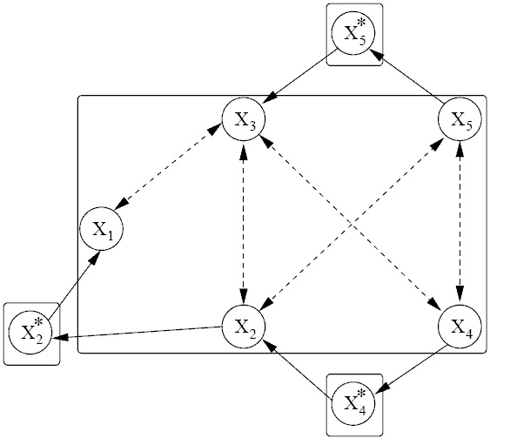
Step 3: The non-barren case

Slide 35
Parameter learning
For the purposes of illustration, assume a finite mixture of experts for the conditional marginals for continuous data
For discrete data, just use the standard CPT formulation found in Bayesian networks

Slide 36
Parameter learning
Copulas: we use a bi-variate formulation only (so we take products “over edges” instead of “over cliques”).
In the experiments: Frank copula

Slide 37
Parameter learning
Suggestion: two-stage quasiBayesian learning
Analogous to other approaches in the copula literature
Fit marginal parameters using the posterior expected value of the parameter for each individual mixture of experts
Plug those in the model, then do MCMC on the copula parameters
Relatively efficient, decent mixing even with random walk proposals
Nothing stopping you from using a fully Bayesian approach, but mixing might be bad without some smarter proposals
Notice: needs constant CDF-to-PDF/PMF transformations!

Slide 38
Experiments

Slide 39
Experiments

Slide 40
The story so far
General toolbox for construction for ADMG models
Alternative estimators would be welcome:
Bayesian inference is still “doubly-intractable” (Murray et al., 2006), but district size might be small enough even if one has many variables
Either way, composite likelihood still simple. Combined with the Huang + Frey dynamic programming method, it could go a long way
Hybrid Moebius/CDN parameterizations to be exploited
Empirical applications in problems with extreme value issues, exploring non-independence constraints, relations to effect models in the potential outcome framework etc.

Slide 41
Back to: Learning Latent Structure
Candidate I
Candidate II
latent
X₁
X₂
X₁
X₃
X₂
Y₁
Y₃
Y₆
Y₄
Y₁
Y₃
Y₆
Y₂
Y₂
observed
Y₄
Y₅
Y₅
Difficulty on computing scores or tests
Identifiability: theoretical issues and implications to optimization

Slide 42
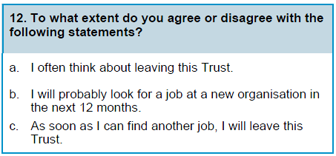
Leveraging Domain Structure
Exploiting “main” factors
X₁₂
X₇
Y_{12a}
Y_{12b}
Y_{12c}
Y_{7a}
Y_{7b}
Y_{7c}
Y_{7d}
Y_{7e}
(NHS Staff Survey, 2009)

Slide 43
The “Structured Canonical Correlation” Structural Space
X
X₁
X₂
X₃
X₄
X₅
X∞
Y₁
Y₂
Y₃
Y₄
Y₅
Y₆
Set of pre-specified latent variables X, observations Y
Each Y in Y has a pre-specified single parent in X
Set of unknown latent variables X∞ X
Each Y in Y can have potentially infinite parents in X∞
“Canonical correlation” in the sense of modeling dependencies within a partition of observed variables

Slide 44
The “Structured Canonical Correlation”: Learning Task
X₁
X₂
Y₁
Y₂
Y₃
Y₄
Y₅
Y₆
Assume a partition structure of Y according to X is known
Define the mixed graph projection of a graph over (X, Y) by a bi-directed edge Y_{i} ↔ Y_{j} if they share a common ancestor in X∞
Practical assumption: bi-directed substructure is sparse
Goal: learn bi-directed structure (and parameters) so that one can estimate functionals of P(X | Y)

Slide 45
Parametric Formulation
X ~ N(0, Σ), Σ positive definite
Ignore possibility of causal/sparse structure in X for simplicity
For a fixed graph G, parameterize the conditional cumulative distribution function (CDF) of Y given X according to bi-directed structure:
F(y | x) ≡ P(Y ≤ y | X = x) ≡ ∏ P_{i}(Y_{i} ≤ y_{i} | X_{[i]} = x_{[i]})
Each set Y_{i} forms a bi-directed clique in G, X_{[i]} being the corresponding parents in X of the set Y_{i}
We assume here each Y is binary for simplicity

Slide 46
Parametric Formulation
In order to calculate the likelihood function, one should convert from the (conditional) CDF to the probability mass function (PMF)
P(y, x) = {ΔF(y | x)} P(x)
ΔF(y | x) represents a difference operator. As we discussed before, for p-dimensional binary (unconditional) F(y) this boils down to

Slide 47
Learning with Marginal Likelihoods
For X_{j} parent of Y_{i} in X:
Let
Marginal likelihood:
Pick graph G_{m} that maximizes the marginal likelihood (maximizing also with respect to Σ and β), where θ parameterizes local conditional CDFs F_{i}(y_{i} | x_{[i]})

Slide 48
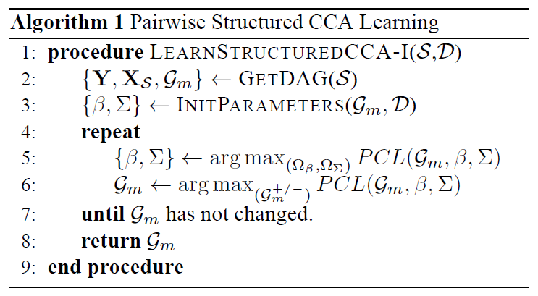
Computational Considerations
Intractable, of course
Including possible large tree-width of bi-directed component
First option: marginal bivariate composite likelihood
Integrates θ_{ij} and X^{1:N} with a crude quadrature method
G_{m}^{+/-} is the space of graphs that differ from G_{m} by at most one bi-directed edge

Slide 49
Beyond Pairwise Models
Wanted: to include terms that account for more than pairwise interactions
Gets expensive really fast
An indirect compromise:
Still only pairwise terms just like PCL
However, integrate θ_{ij} not over the prior, but over some posterior that depends on more than on Y_{i}^{1:N}, Y_{j}^{1:N}:
Key idea: collect evidence from p(θ_{ij} | Y_{S}^{1:N}), {i, j} ⊂ S, plug it into the expected log of marginal likelihood . This corresponds to bounding each term of the log-composite likelihood score with different distributions for θ_{ij}:

Slide 50
Beyond Pairwise Models
New score function
S_{k}: observed children of X_{k} in X
Notice: multiple copies of likelihood for θ_{ij} when Y_{i} and Y_{j} have the same latent parent
Use this function to optimize parameters {β, Σ}
(but not necessarily structure)

Slide 51
Learning with Marginal Likelihoods
Illustration: for each pair of latents X_{i}, X_{j}, do
i
_{j}
Defines
q_{ij}(θ_{ij}) ≡ p(θ_{ij} | Y_{S}, Σ, β)
Compute by Laplace approximation and dynamic programming
Y_{ij1a}
θ_{ijk}
Y_{ij1b}
~
q_{ij}(θ_{ij})
Marginalize
and add term
… + E_{q(θijk)}[log P(Y_{ij1a}, Y_{ij1b,} θ_{ijk} | Σ, β)] + …
~

Slide 52
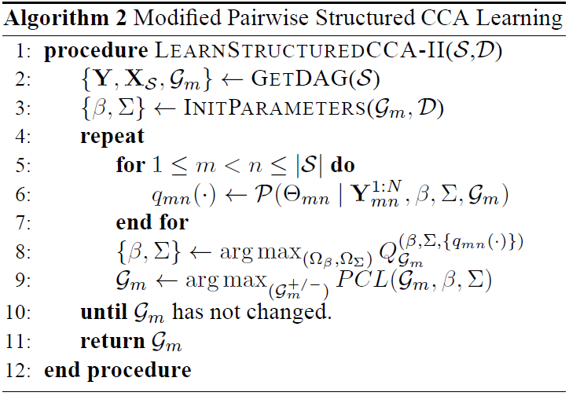
Algorithm 2
q_{mn} comes from conditioning on all variables that share a parent with Y_{i} and Y_{j}
In practice, we use PCL when optimizing structure
EM issues with discrete optimization: model without edge has an advantage, sometimes bad saddlepoint

Slide 53
Experiments: Synthetic Data
20 networks of 4 latent variables with 4 children per latent variable
Average number of bi-directed edges: ~18
Evaluation criteria:
Mean-squared error of estimate of slope β for each observed variable
Edge omission error (false negatives)
Edge commission error (false positives)
Comparison against “single-shot” learning
Fit model without bi-directed edges, add edge Y_{i} ↔ Y_{j} if implied pairwise distribution P(Y_{i}, Y_{j}) doesn’t fit the data
Essentially a single iteration of Algorithm 1

Slide 54
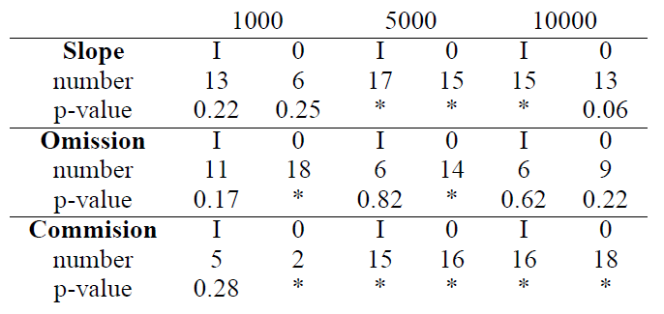
Experiments: Synthetic Data
Quantify results by taking the difference between number of times Algorithm 2 does better than Algorithm 1 and 0 (“single-shot” learning)
The number of times where the difference is positive with the corresponding p-values for a Wilcoxon signed rank test (stars indicate numbers less than 0.05)

Slide 55
Experiments: NHS Data
Fit model with 9 factors and 50 variables on the NHS data, using questionnaire as the partition structure
100,000 points in training set, about 40 edges discovered
Evaluation:
Test contribution of bi-directed edge dependencies to P(X | Y): compare against model without bi-directed edges
Comparison by predictive ability: find embedding for each X^{(d)} given Y^{(d)} by maximizing
Test on independent 50,000 points by evaluating how well we can predict other 11 answers based on latent representation using logistic regression

Slide 56
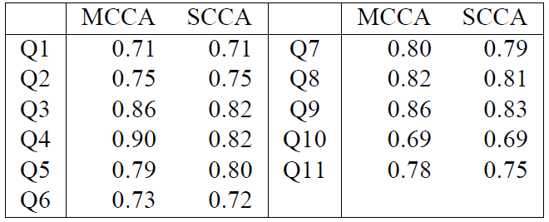
Experiments: NHS Data
MCCA: mixed graph structured canonical correlation model
SCCA: null model (without bi-directed edges)
Table contains AUC scores for each of the 11 binary prediction problems using estimated X as covariates:

Slide 57
Conclusion
Marginal composite likelihood and mixed graph models are a good match
Still requires some choices of approximations for posteriors over parameters, and numerical methods for integration
Future work:
Theoretical properties of the alternative marginal composite likelihood estimator
Identifiability issues
Reduction on the number of evaluations of q_{mn}
Non-binary data
Which families could avoid multiple passes over data?

